Slide 1
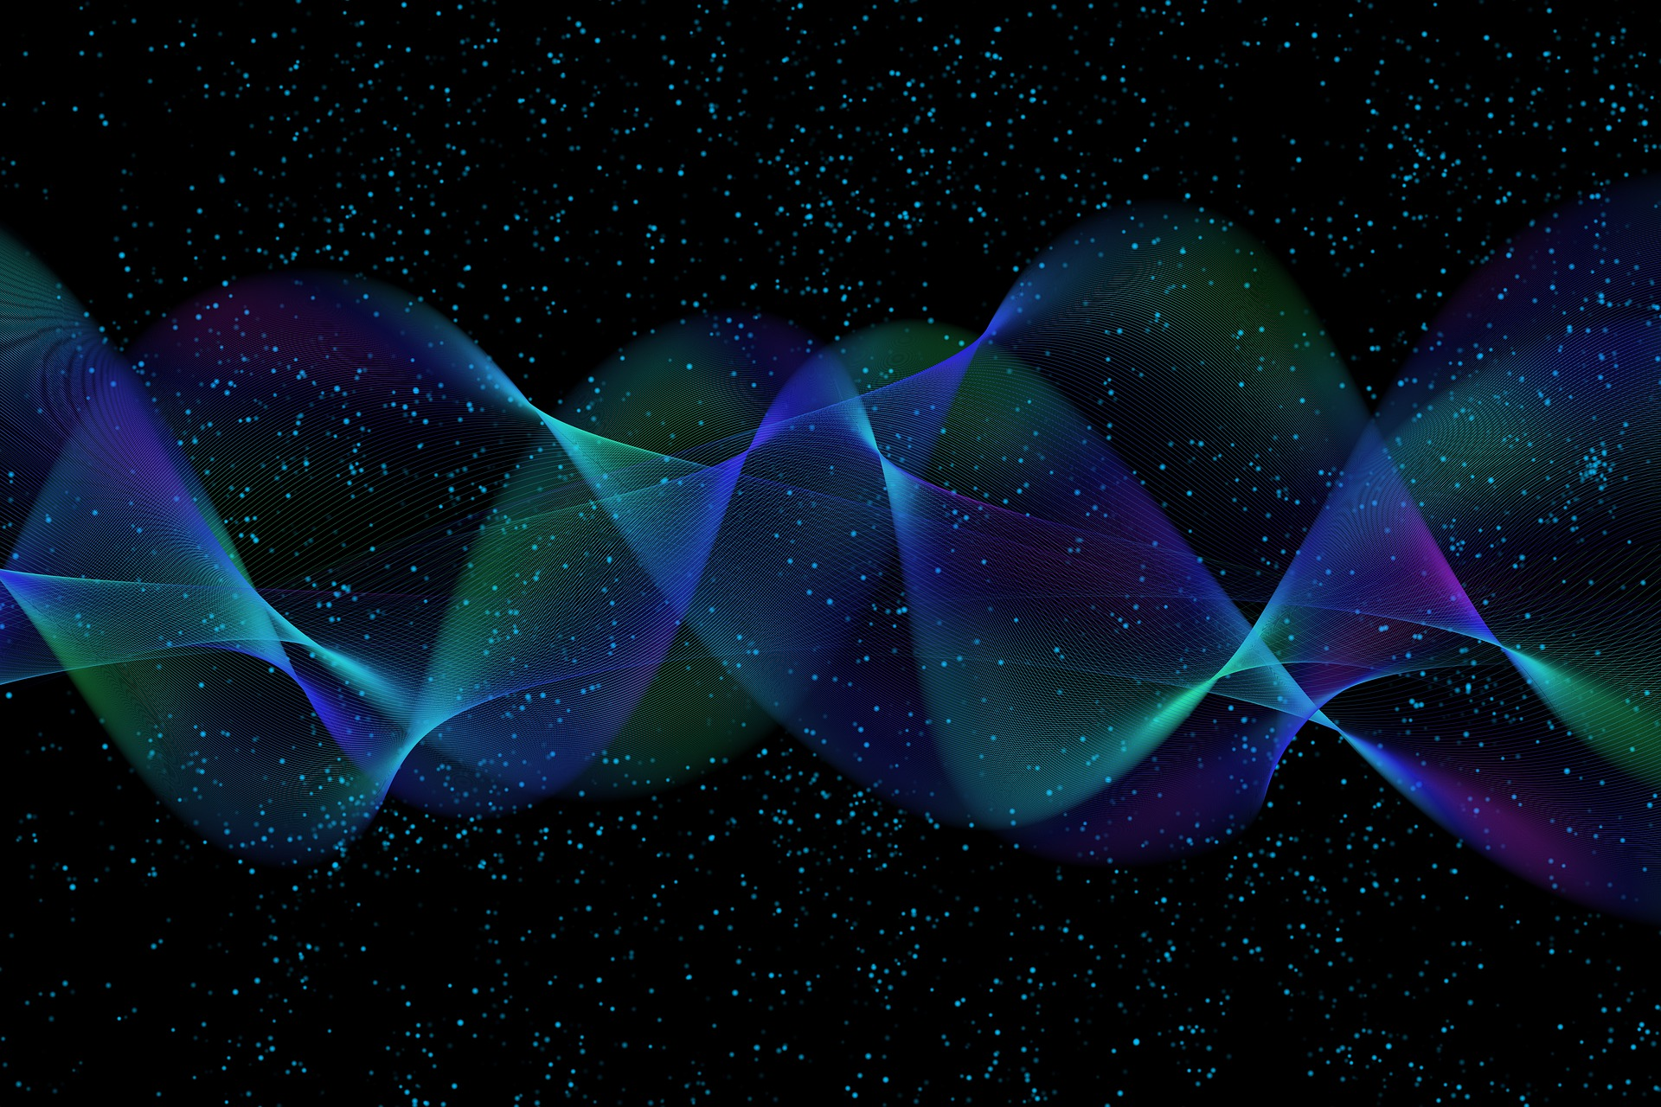
Quantum Computing
8. Elements of Quantum Algorithms
Quantum Computing Insitute
https://qcict.org
Prof. Aleksandar Radovanovic
alex@qcict.org

Slide 2
Core components of quantum algorithms
phase
kickback
quantum
measurement
phase
estimation
quantum
entanglement
data
encoding
quantum
superposition
Fourier
transform
quantum
interference
quantum
arithmetic
function
evaluation
quantum
oracle
Notes:
Quantum algorithms rely on several key components and techniques that can give them advantages over classical methods for certain problems.
Encoding data into quantum states means representing information using qubits.
Quantum arithmetic provides a way to perform operations such as addition, multiplication, and modular arithmetic on quantum registers.
Function evaluation is a basic building block of many quantum algorithms, where a quantum circuit is used to compute a function while preserving quantum superposition.
Quantum oracles act as black-box functions that provide information used by algorithms for problems such as search and optimization.
Quantum superposition allows a quantum state to contain multiple computational-basis states at the same time, allowing many possibilities to be processed together.
Quantum interference can amplify the probability of desired results and suppress the probability of undesired ones.
Phase kickback is a technique in which the action of a controlled operation introduces a phase into another part of the quantum state.
Quantum entanglement creates strong correlations between qubits that have no direct classical counterpart.
Quantum measurement extracts classical information from quantum states, with different measurement bases revealing different properties.
Quantum Fourier transform (QFT) is a fundamental subroutine that transforms quantum amplitudes in a way analogous to the classical discrete Fourier transform.
Quantum phase estimation (QPE) is a method for estimating the phase associated with an eigenvalue of a unitary operation.

Slide 3

Encoding data
into quantum states

Slide 4

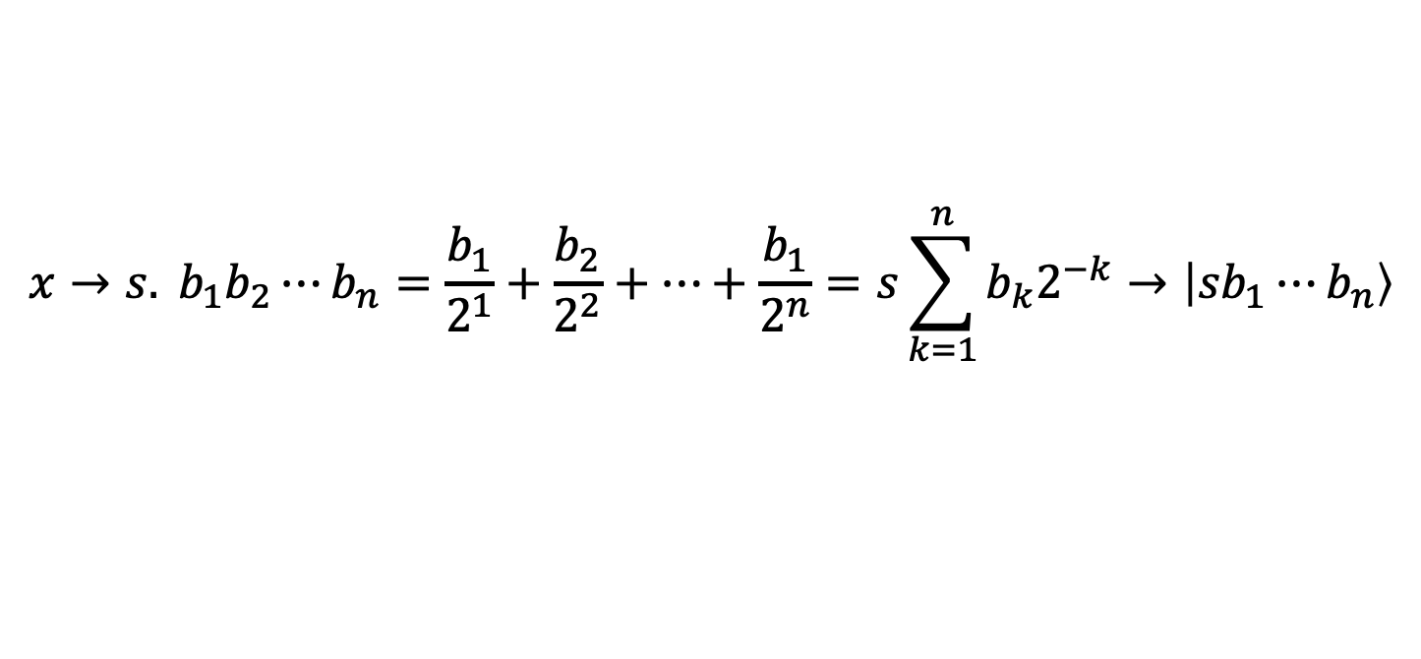

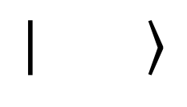
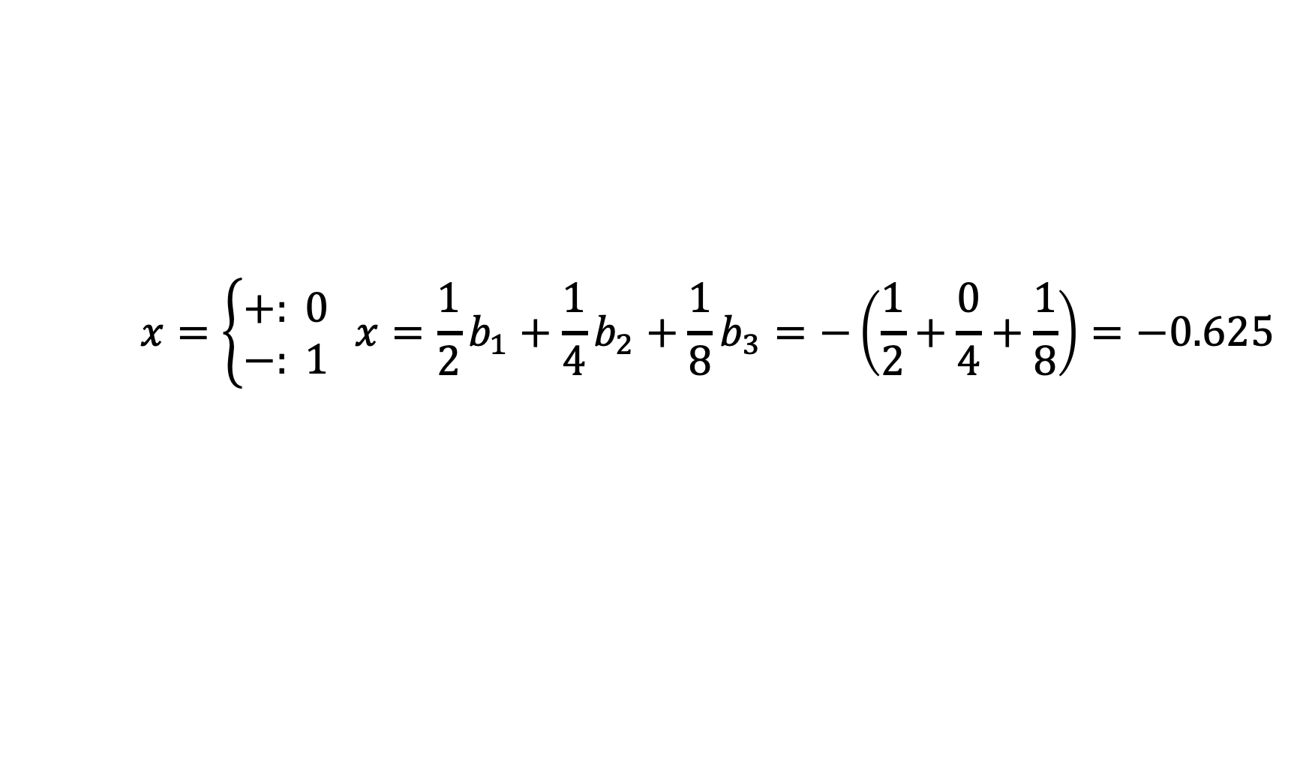
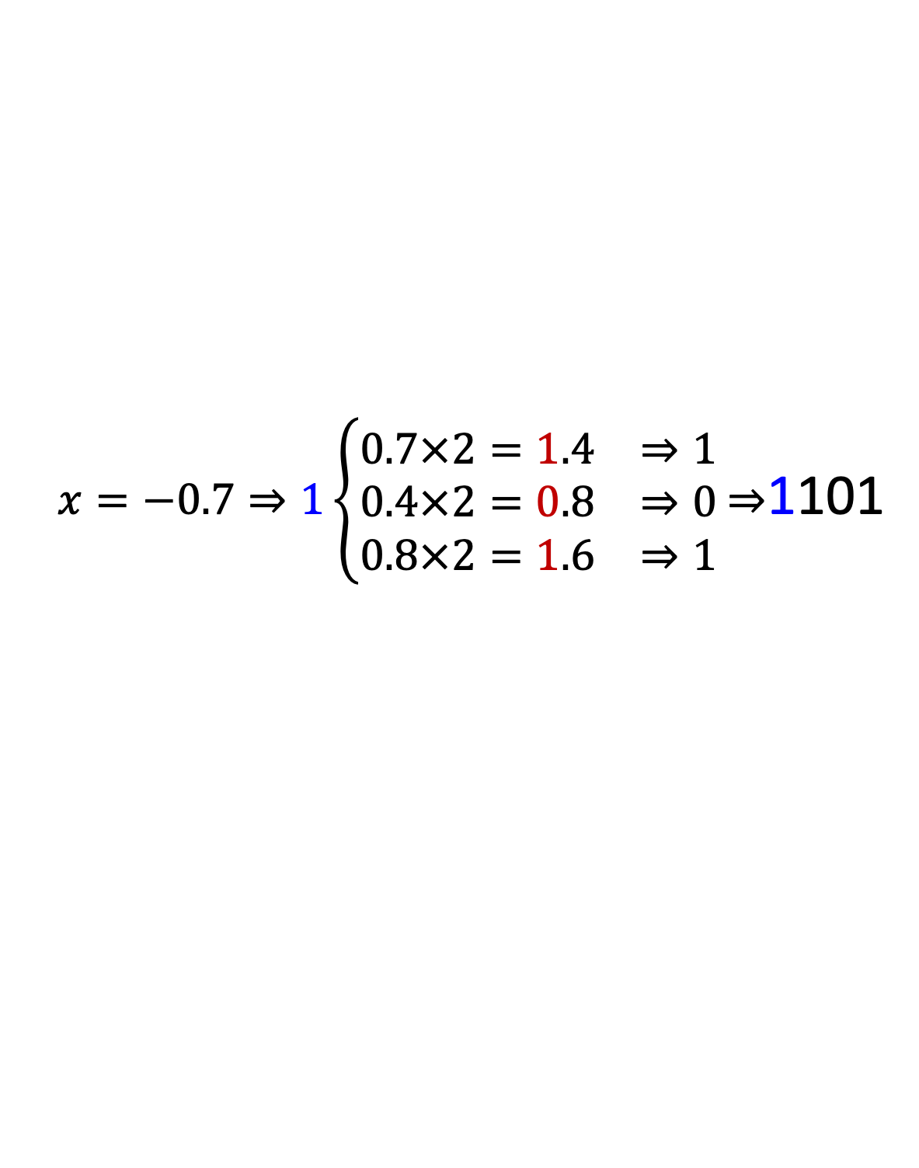
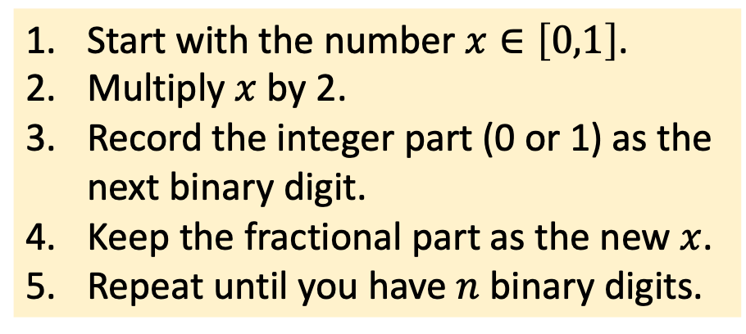
Encoding Real Numbers into Basis States
$$b_{0}{ b}_{1}$$
$$q_{0}{ q}_{1}$$
$$x→s. b_{1}b_{2}⋯b_{n}=\frac{b_{1}}{2^{1}}+\frac{b_{2}}{2^{2}}+⋯+\frac{b_{1}}{2^{n}}=s\sum_{k=1}^{n}{b_{k}2^{−k}}→\left|{sb}_{1}⋯b_{n}\right\rangle$$
1
0
1
0
Start with the number $x∈\left[0,1\right]$.
Multiply $x$ by 2.
Record the integer part (0 or 1) as the
next binary digit.
Keep the fractional part as the new $x$.
Repeat until you have $n$ binary digits.
Example:
$x=−0.7⇒1\left\{\begin{matrix}0.7×2=1.4 & ⇒1 \\ 0.4×2=0.8 & ⇒0 \\ 0.8×2=1.6 & ⇒1\end{matrix}\right.$ $⇒$1101
$$x=\left\{\begin{matrix}+: 0 \\ −: 1\end{matrix}\right. x={\frac{1}{2}b}_{1}+{\frac{1}{4}b}_{2}+{\frac{1}{8}b}_{3}=−\left(\frac{1}{2}+\frac{0}{4}+\frac{1}{8}\right)=−0.625$$
Notes:
Basis encoding means taking classical binary data, made up of 0s and 1s, and mapping it directly onto the computational basis states of a quantum system. For example, the classical bit string 10 becomes the quantum state ∣10⟩.
In practice, however, data is often given as real numbers rather than binary integers. One way to encode such data is to first normalize it to a chosen range, for example between −1 and +1, and then represent each number using a fixed-point binary format. The first bit can be used for the sign (s=0 for positive and s=1 for negative), while the remaining bits represent the fractional part.
The example shows how to encode −0.7 using 3 fractional bits:
Write a leading 1 to indicate that the number is negative.
Take the magnitude, 0.7, multiply it by 2, record the integer part as the next bit, and keep the fractional remainder.
Repeat the process until the required number of bits has been obtained.
To decode, we reverse the process: each binary digit is multiplied by the corresponding power of 1/2, and the results are added together to approximate the original number.
The drawback is that this method can require many qubits, especially when encoding large datasets or using high precision.

Slide 5
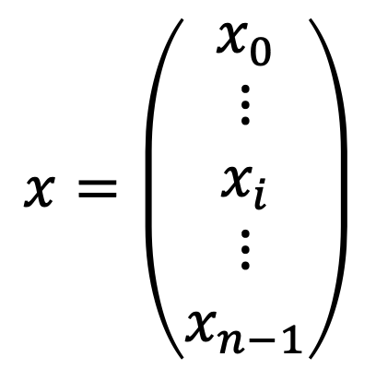

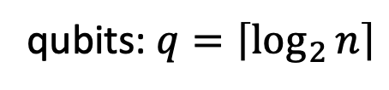
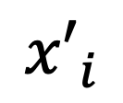
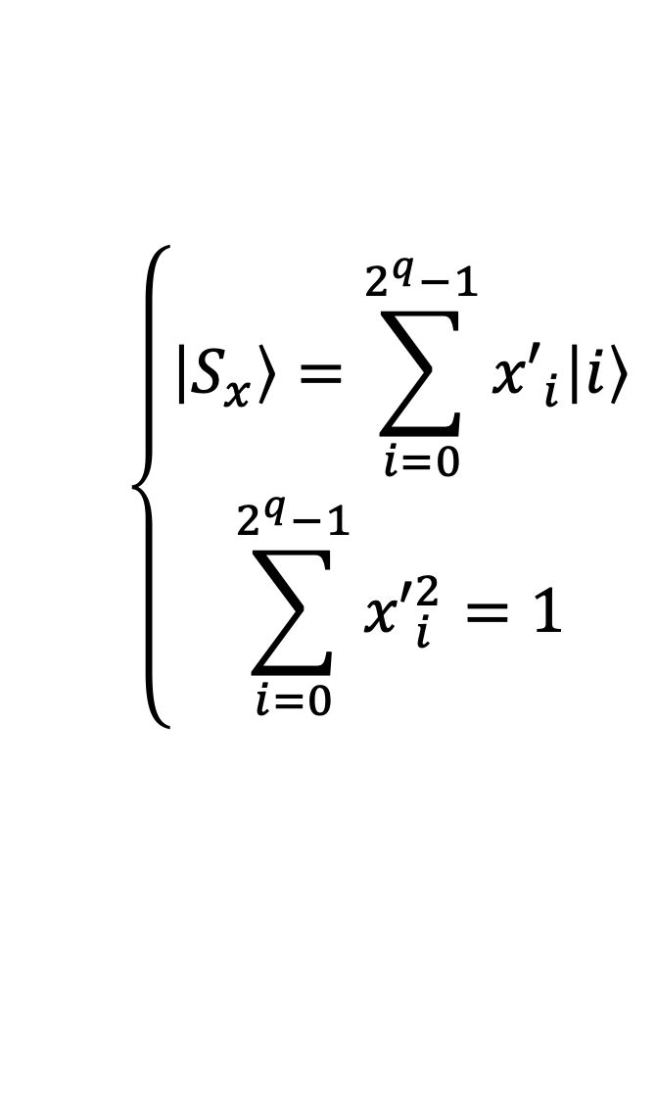



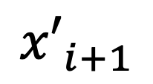



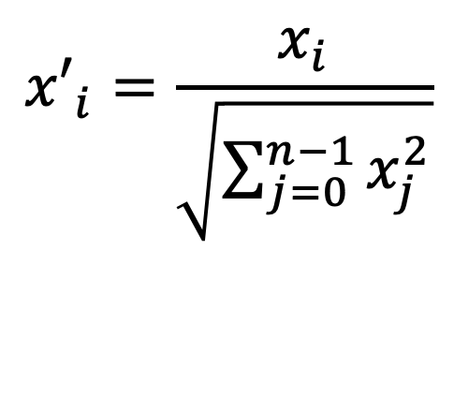



Amplitude Encoding
$$\left|0\right\rangle$$
$$⋮$$
$$U(x)$$
$$V(θ)$$
$$M$$
$$O$$
$$\left|0\right\rangle$$
x₀
x₁
$$x_{0}^{′}\left|\text{0}\right\rangle +x_{1}^{′}\left|\text{1}\right\rangle$$
qubits: $q=\left\lceil \log_{2}{n}\right\rceil$
$$\left\{\begin{aligned}\left|S_{x}\right\rangle =\sum_{i=0}^{2^{q}−1}{{x′}_{i}\left|i\right\rangle } \\ \sum_{i=0}^{2^{q}−1}{{x′}_{i}^{2}}=1\end{aligned}\right.$$
$$x=\left(\begin{matrix}x_{0} \\ ⋮ \\ x_{i} \\ ⋮ \\ x_{n−1}\end{matrix}\right)$$
$${x′}_{i}$$
$${x′}_{i}=\frac{x_{i}}{\sqrt{\sum_{j=0}^{n−1}{x_{j}^{2}}}}$$
$${x′}_{i+1}$$
$$\left|i\right\rangle$$
$$\left|i+1\right\rangle$$
Euclidean norm
(L2 norm)
classical vector
quantum state vector
Notes:
If the data is given as a vector of numbers, another approach is amplitude encoding. Here, the components of the vector are encoded into the probability amplitudes of a quantum state.
Real-valued data are first normalized using the Euclidean norm, which is the square root of the sum of the squares of all vector components.
The normalized values are then used directly as the probability amplitudes of the quantum state.
Amplitude encoding is very efficient in terms of qubit usage, but preparing the required quantum state can be technically challenging and resource-intensive.
If the original vector has dimension $n$, the number of qubits required is $q=\left\lceil \log_{2}{n}\right\rceil$ since $q$ qubits provide $2^{q}$ computational basis states. If n is smaller than $2^{q}$, the remaining amplitudes are set to zero, which is known as zero-padding.

Slide 6
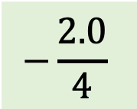
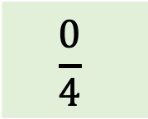
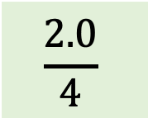
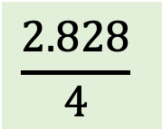
From Data to Amplitudes
Example:
-2.0
2.828
–2.0
0.0
data
normalization constant
$$C_{norm}=\sqrt{(−{2)}^{2}+{2.82}^{2}+2^{2}+0^{2}}=\sqrt{16}=4$$
$$−\frac{2.0}{4}$$
$$\frac{2.828}{4}$$
$$\frac{2.0}{4}$$
$$\frac{0}{4}$$
normalized data
encoded data
$$−1/2\left|00\right\rangle +1/\sqrt{2}\left|01\right\rangle −1/2 \left|10\right\rangle +0 \left|11\right\rangle$$
Notes:
The example shows a vector of four real numbers that we want to encode into the probability amplitudes of a quantum state.
Since the sum of the squares of the amplitudes must equal 1, the first step is to calculate the Euclidean norm of the data vector.
Each data value is then normalized by dividing it by this norm.
Finally, the normalized values are used as the amplitudes of the quantum state, while the computational basis states serve as indices for the components of the data vector.

Slide 7
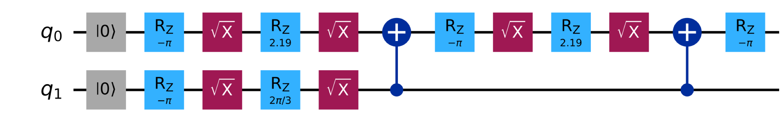
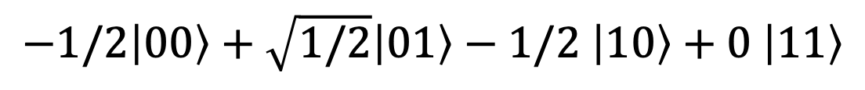
Preparing the Quantum State
$$−1/2\left|00\right\rangle +\sqrt{1/2}\left|01\right\rangle −1/2 \left|10\right\rangle +0 \left|11\right\rangle$$
qc.initialize([-0.5, np.sqrt(0.5), -0.5, 0], [0, 1])
Notes:
In this example, the calculated amplitudes are passed as arguments to Qiskit’s initialize method, which prepares the qubits in the required quantum state.
For small cases, this is straightforward, but as the number of qubits increases, state preparation becomes more complex. The reason is that the required transformation must be decomposed into standard quantum gates, with the appropriate parameters determined for each gate.

Slide 8

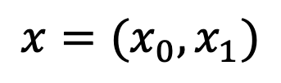

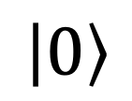








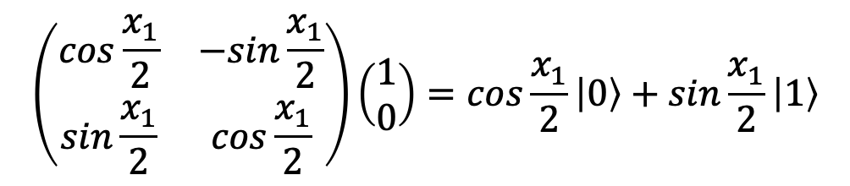

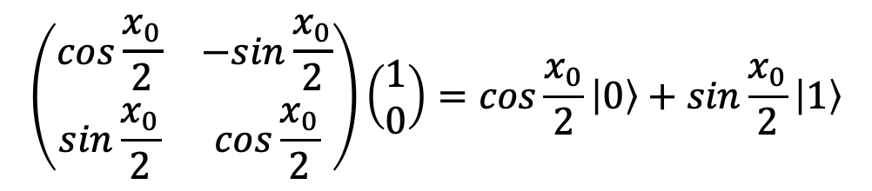
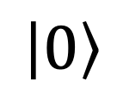


Angle Encoding
$$z$$
$$\left|0\right\rangle$$
Real
plane
$$x$$
$$x$$
$$x$$
$$y$$
$$x$$
$$x=(x_{0},x_{1})$$
$$\left|1\right\rangle$$
$$\left(\begin{matrix}\cos{\frac{x_{0}}{2}} & −sin{\frac{x_{0}}{2}} \\ \sin{\frac{x_{0}}{2}} & \cos{\frac{x_{0}}{2}}\end{matrix}\right)\left(\begin{matrix}1 \\ 0\end{matrix}\right)=\cos{\frac{x_{0}}{2}}\left|0\right\rangle +\sin{\frac{x_{0}}{2}}\left|1\right\rangle$$
$$q_{0}$$
$$\left|0\right\rangle$$
$$RY\left(x_{0}\right)$$
$$⨂$$
$$q_{1}$$
$$\left(\begin{matrix}\cos{\frac{x_{1}}{2}} & −sin{\frac{x_{1}}{2}} \\ \sin{\frac{x_{1}}{2}} & \cos{\frac{x_{1}}{2}}\end{matrix}\right)\left(\begin{matrix}1 \\ 0\end{matrix}\right)=\cos{\frac{x_{1}}{2}}\left|0\right\rangle +\sin{\frac{x_{1}}{2}}\left|1\right\rangle$$
$$\left|0\right\rangle$$
$$RY\left(x_{1}\right)$$
Notes:
Angle encoding is a way of loading classical data into qubits by using the data values to determine rotation angles.
Each component of a classical data vector is first scaled to a suitable range and then used to set the rotation angle of a corresponding qubit, for example using RX​, RY​, or RZ​ gates.
If the vector has n components, the straightforward approach typically requires n qubits, one for each data value.
In practice, fewer qubits can be used through data re-uploading, where the same qubits are used to encode multiple data values through successive rotations.
For example, for a two-dimensional vector, we can use two qubits and apply one rotation to each. Here, RY​ rotations are used because they create a superposition with real probability amplitudes when starting from ∣0⟩. This makes RY​ rotations a natural choice for encoding real-valued data. The amplitudes therefore remain real, which makes RY​ rotations a natural choice for encoding real-valued data.
Since each data value is encoded into an individual qubit, the complete encoded state is obtained as the tensor product of the individual qubit states.

Slide 9
Example of Angle Encoding
1
Data: $x=\left(x_{1},x_{2},⋯x_{n}\right), x_{min}, x_{max}$
Data: 𝑥=(𝑥_1,𝑥_2,⋯𝑥_𝑛 ), 𝑥_𝑚𝑖𝑛, 𝑥_𝑚𝑎𝑥
2
Normalization $\left[0,1\right]:$ $x_{i_norm}=\frac{x_{i}−x_{min}}{x_{max}−x_{min}}$
Normalization [0,1]: 𝑥_(𝑖_𝑛𝑜𝑟𝑚)=(𝑥_𝑖−𝑥_𝑚𝑖𝑛)/(𝑥_𝑚𝑎𝑥−𝑥_𝑚𝑖𝑛 )
3
Calculate angles $\left[0,2π\right]$: $θ_{i}={2πx}_{i_norm}$
Calculate angles [0,2𝜋]: θ_𝑖=〖2𝜋𝑥〗_(𝑖_𝑛𝑜𝑟𝑚)
4
Calculate angles $\left[−π,π\right]$: $θ_{i}={2πx}_{i_norm}−π$
Calculate angles [−𝜋,𝜋]: θ_𝑖=〖2𝜋𝑥〗_(𝑖_𝑛𝑜𝑟𝑚)−𝜋
5
Encode into a circuit: ${Ry(θ}_{i})$
Encode into a circuit: 〖𝑅𝑦(θ〗_𝑖)
Notes:
Consider a vector $x$, with each component taking values between a known minimum $x_{min}$​ and maximum $x_{max}$
In the first step, the vector components are scaled to the interval $\left[0,1\right]$.
If the data is to be encoded using angles in the interval $\left[0,2π\right]$, each scaled component $x_{i_norm}$​ is mapped to a rotation angle $θ_{i}={2πx}_{i_norm}$
Alternatively, if the data is to be encoded using angles in the interval $\left[−π,π\right]$, the mapping becomes $θ_{i}={2πx}_{i_norm}−π$.
We then use these angles in the quantum circuit by applying the corresponding rotation gates to the qubits.

Slide 10

?
1+1=0
Quantum
Arithmetic

Slide 11
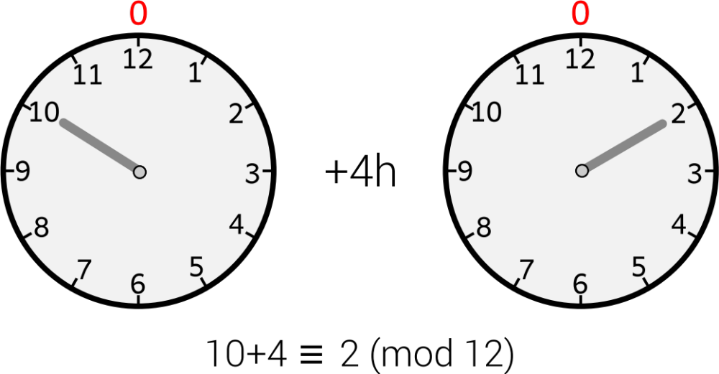

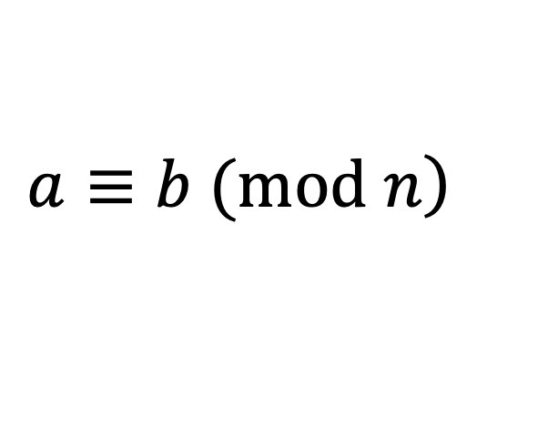
MathBox: Modular Arithmetic in Quantum Computing
(modulus)
(modulus)
congruence relation
$$\left.a≡b (mod n\right)$$
($a$ is congruent to $b$ modulo $n$)
$a$ and $b$ have the same remainder when divided by $n$
Notes:
Quantum computing makes extensive use of modular arithmetic. It is a type of arithmetic in which integers “wrap around” after reaching a certain value called the modulus.
A simple example is a 12-hour clock: after 12, we return to 1 again. Here, 12 is the modulus. This illustrates the periodic nature of modular arithmetic, where values repeat after a fixed interval.
In mathematics, modular arithmetic is described using a congruence relation. We write $\left.a≡b (mod n\right)$, which means that a and b have the same remainder when divided by n.

Slide 12
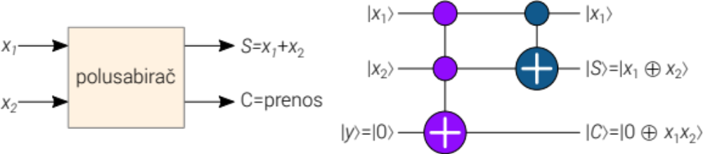
Quantum Half-Adder
half-adder
carry
x₁ | x₂ | S | C
0 | 0 | 0 | 0
0 | 1 | 1 | 0
1 | 0 | 1 | 0
1 | 1 | 0 | 1
Notes:
A half-adder performs the addition of two binary digits. It takes two input bits, x1​ and x2​, and produces two outputs:
The sum S, which is the XOR of the two inputs and therefore represents addition modulo 2.
The carry C, which is 1 only when both inputs are 1.
The truth table shows how the half-adder works. If both inputs are 0, the sum is 0. If one input is 1, the sum is 1. But when both inputs are 1, the sum wraps back to 0 and the carry bit C becomes 1. This is similar to regular decimal addition: when a digit exceeds its allowed range, it resets and a carry is passed to the next position.
A quantum half-adder circuit can be built using two types of gates:
A CNOT gate to compute the sum S.
A Toffoli (CCNOT) gate to compute the carry C.

Slide 13
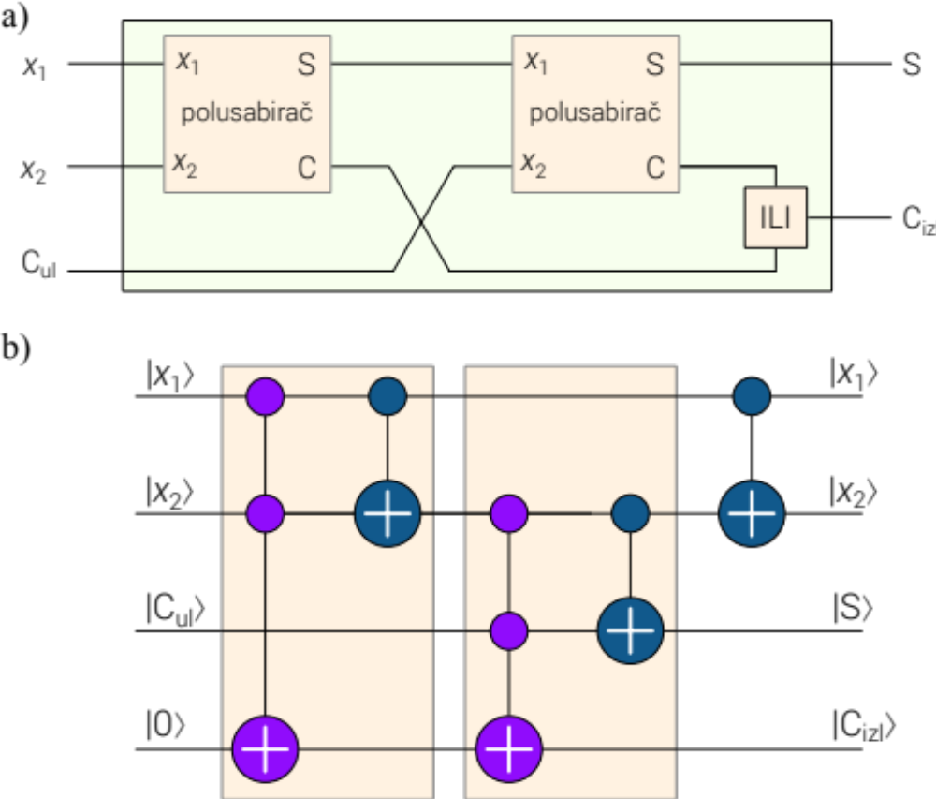
Quantum Adder
half-adder
half-adder
OR
C_{out}
|C_{in} ⟩
|C_{out} ⟩
Notes:
By combining two half-adders, we can build a full adder, shown in Figure a). It adds three input bits: x1​, x2​, and a carry-in Cin​ from the previous stage. It produces the sum S and carry-out Cout​. The carry-out is obtained by combining the internal carry values from the two half-adders.
Figure b) shows a quantum implementation of the full adder using CNOT and Toffoli gates.
Unlike a classical adder, a quantum adder can operate on superpositions of input values, producing a corresponding superposition of possible results. This makes quantum arithmetic an important building block in many quantum algorithms.

Slide 14
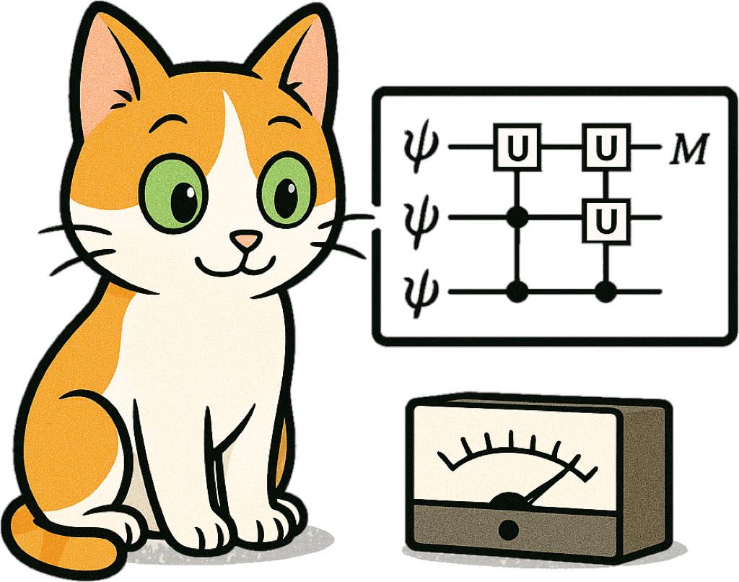
Function
evaluation
Notes:
Function evaluation is a basic task in any kind of computing. Boolean functions are particularly important in quantum computing, and several quantum algorithms use them to achieve speedups over classical methods. More complex functions, such as trigonometric or exponential functions, are more challenging to implement efficiently and remain an active area of research.

Slide 15
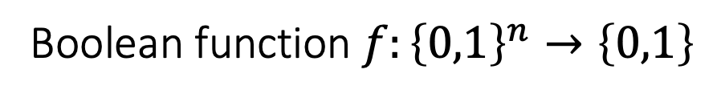
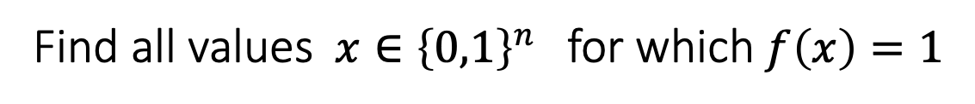
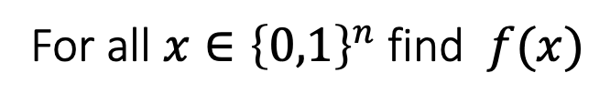
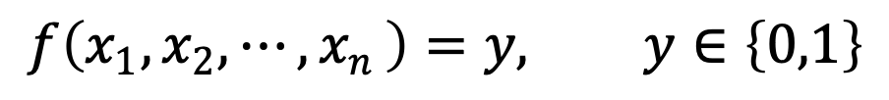
Boolean Functions Evaluation
Boolean function $f:{\left\{0,1\right\}}^{n}→\left\{0,1\right\}$
$$f\left(x_{1},x_{2},{⋯,x}_{n}\right)=y, y∈\left\{0,1\right\}$$
Complete function evaluation
For all ${x∈\left\{0,1\right\}}^{n}$ find $f(x)$
Boolean satisfiability (SAT) problem
Find all values ${x∈\left\{0,1\right\}}^{n}$ for which $f\left(x\right)=1$
Notes:
A Boolean function maps n binary input variables to a single binary output. The result is either true or false, represented by the classical bit values 1 and 0.
Two important computational tasks involving Boolean functions are:
Exhaustive evaluation: Evaluating the function for all possible input combinations. For n input bits, there are 2^{n} possible combinations.
Satisfiability (SAT): Determining whether there is at least one input combination for which the function is true (1), and often finding such an input. SAT plays a central role in computational complexity theory and has applications in optimization, verification, cryptography, and combinatorial problems.

Slide 16



Encoding Boolean Functions in Quantum Circuits
$$\left|c_{1}\right\rangle$$
+
$$\left|c_{2}\right\rangle$$
+
+
$$\left|t\right\rangle$$
X
CNOT
CCNOT
Notes:
Any Boolean function can be implemented in a quantum circuit using a small set of reversible gates, such as the X, CNOT, and Toffoli gates. Together, these gates can be used to construct quantum versions of classical logical operations.
The X gate acts as the quantum equivalent of NOT.
The CNOT gate can implement the XOR operation.
The Toffoli (CCNOT) gate can be used to construct operations such as AND and, together with other reversible gates, can implement arbitrary Boolean functions.

Slide 17
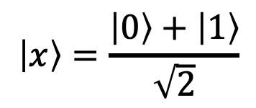

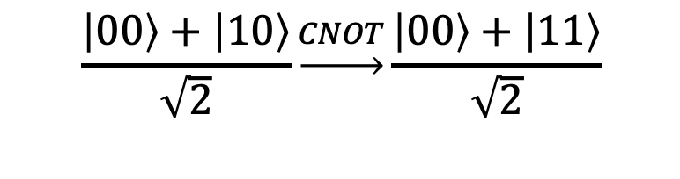

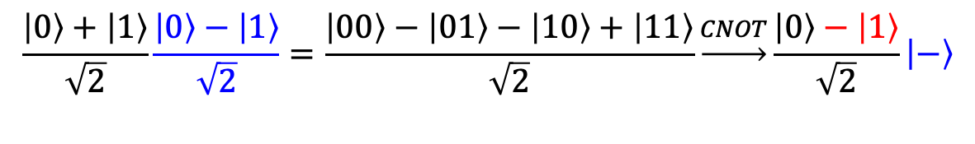
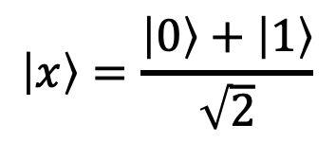
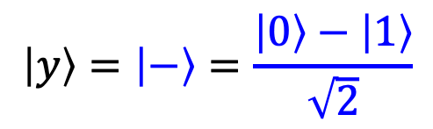
Implementing $f\left(x\right)=x$ with a CNOT gate
Function evaluation
Solving SAT problem
$$\left|x\right\rangle =\frac{\left|0\right\rangle +\left|1\right\rangle }{\sqrt{2}}$$
$$\left|x\right\rangle =\frac{\left|0\right\rangle +\left|1\right\rangle }{\sqrt{2}}$$
+
$$\left|y\right\rangle =\left|−\right\rangle =\frac{\left|0\right\rangle −\left|1\right\rangle }{\sqrt{2}}$$
+
$$\left|y\right\rangle =\left|0\right\rangle$$
$\left|y\right\rangle =$ $\left|y\right\rangle ⨁\left|x\right\rangle$
$$\frac{\left|00\right\rangle +\left|10\right\rangle }{\sqrt{2}}\underset{→}{CNOT}\frac{\left|00\right\rangle +\left|11\right\rangle }{\sqrt{2}}$$
$$\frac{\left|0\right\rangle +\left|1\right\rangle }{\sqrt{2}}\frac{\left|0\right\rangle −\left|1\right\rangle }{\sqrt{2}}=\frac{\left|00\right\rangle −\left|01\right\rangle −\left|10\right\rangle +\left|11\right\rangle }{\sqrt{2}}\underset{→}{CNOT}\frac{\left|0\right\rangle −\left|1\right\rangle }{\sqrt{2}}\left|−\right\rangle$$
Notes:
As a simple example, consider the Boolean function $f\left(x\right)=x$. This function can be implemented with just one CNOT gate.
The left side shows the function evaluation. The control qubit represents the input ∣x⟩, while the target qubit represents the output ∣y⟩, which is initialized to ∣0⟩. If the control qubit is ∣0⟩, the target remains ∣0⟩. If the control qubit is ∣1⟩, the target flips to ∣1⟩, thus implementing $f\left(x\right)=x$. If the control qubit is in a superposition, the output becomes a superposition of the two possible input-output pairs, with the first qubit representing the input and the second representing the output.
The right side shows how to mark the solutions for which the function is true. Initially, the control qubit is in a superposition of possible inputs, while the target qubit is in the state ∣−⟩. After applying the CNOT gate, the control qubit remains in superposition, but its ∣1⟩ component acquires a minus sign. In this way, the circuit marks the input ∣1⟩ as the solution, because for this input the function is true, i.e., $f\left(1\right)=1$. The target qubit remains in the state ∣−⟩.

Slide 18


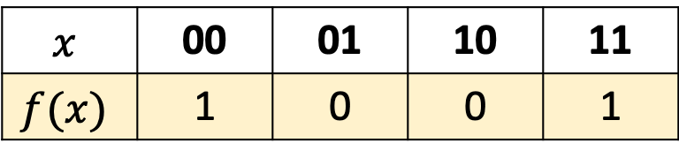
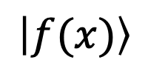
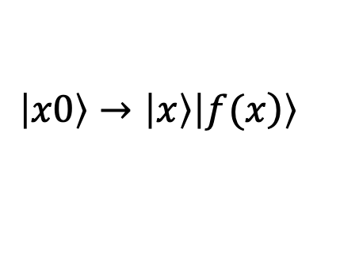

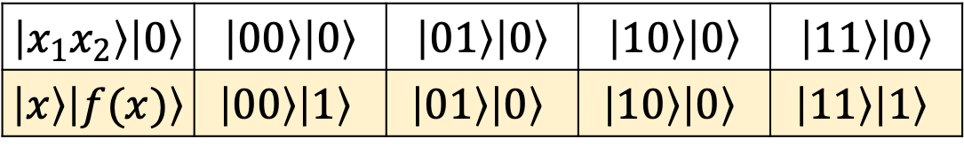

Example: Two-Variable Boolean Function
$$\left|x0\right\rangle →\left|x\right\rangle \left|\left.f(x\right)\right\rangle$$
$$x$$ | 00 | 01 | 10 | 11
$$f(x)$$ | 1 | 0 | 0 | 1
$\left|x_{1}x_{2}\right\rangle \left|0\right\rangle$ | $\left|00\right\rangle \left|0\right\rangle$ | $\left|01\right\rangle \left|0\right\rangle$ | $\left|10\right\rangle \left|0\right\rangle$ | $\left|11\right\rangle \left|0\right\rangle$
$\left|x\right\rangle \left|f(x)\right\rangle$ | $$\left|00\right\rangle \left|1\right\rangle$$ | $$\left|01\right\rangle \left|0\right\rangle$$ | $$\left|10\right\rangle \left|0\right\rangle$$ | $$\left|11\right\rangle \left|1\right\rangle$$
NOT XOR
$$\left|x_{1}\right\rangle$$
+
$$\left|x_{2}\right\rangle$$
+
+
$$\left|f(x)\right\rangle$$
$$\left|0\right\rangle$$
Notes:
Now, consider a Boolean function with two input variables. From the truth table, it is clear that the function is XNOR, or NOT XOR. It outputs 1 when the two inputs are equal and 0 when they are different.
The truth table can first be translated into the corresponding quantum input and output states.
Based on these states, a quantum circuit can then be designed to reproduce the same behavior.
Both inputs are ∣0⟩: The CNOT gates do nothing, and the final X gate flips the output from ∣0⟩ to ∣1⟩.
Both inputs are ∣1⟩: Both CNOT gates flip the output, so their effects cancel. The final X gate then flips the output to ∣1⟩.
The inputs are different: Only one CNOT flips the output to ∣1⟩, and the final X gate flips it back to ∣0⟩.
If the inputs are placed in superposition, the circuit produces a superposition of all possible input-output pairs, corresponding to the same truth table.

Slide 19








Example: NOT XOR Function Implementation
$$\left|0\right\rangle$$
H
$$\left|0\right\rangle$$
+
+
$$\left|0\right\rangle$$
H
$$\left|0\right\rangle$$
$$\left|f(x)\right\rangle$$
+
+
$$\left|f(x)\right\rangle$$
+
+
$$\left|0\right\rangle$$
$$\left|0\right\rangle$$
Notes:
The figure shows the quantum circuit implementation of the XNOR function. In the figure on the left, both input qubits are set to ∣0⟩, while the output qubit also starts in ∣0⟩. The amplitude diagram shows the expected result, with the output qubit in state ∣1⟩. Similar tests can be performed for all other input combinations. Notice that in the diagram, the output qubit appears as the leftmost bit due to Qiskit’s little-endian convention.
When the input qubits are placed in superposition, the circuit evaluates the function coherently for all possible inputs. By looking at the amplitude diagram, we can see which input states correspond to which outputs.
In real-world applications, Boolean functions can involve thousands or even tens of thousands of variables. They play an important role in areas such as chip design, graph problems, optimization, and machine learning.

Slide 20

Quantum
oracle
Notes:
The idea of an oracle goes back to ancient times, when oracles were believed to deliver messages from the gods. In computer science, the word has a different but equally intriguing meaning.
In theoretical computer science, an oracle is imagined as a black box: we give it an input, and it returns an answer without considering how the answer is computed internally. In query complexity, the cost of an algorithm is measured by the number of times it queries the oracle. In quantum computing, an oracle can be queried with inputs in superposition, which can reduce the number of queries required for certain problems.
In software testing, the term is used in a more practical way. Here, an oracle is a mechanism that determines whether a program’s output is correct. One common approach is to use test cases for which the correct outputs are already known. If the program produces the expected outputs, those tests are considered successful.

Slide 21
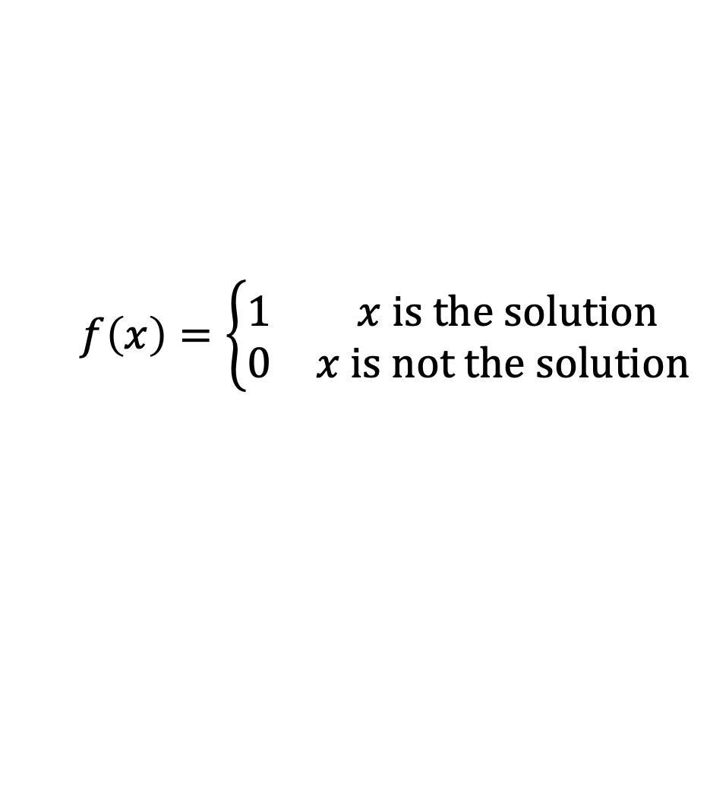

Oracle as a Black Box
1. provides answers
input
oracle
output
x
f(x)
2. check solution
$$f\left(x\right)=\left\{\begin{matrix}1 & x is the solution \\ 0 & x is not the solution\end{matrix}\right.$$
$$f\left(x\right):{\left\{0,1\right\}}^{n}→\left\{0,1\right\}$$
Notes:
A quantum oracle can be thought of as a black box that implements a function $f\left(x\right)$. What matters is its input-output behavior, rather than the internal details of how the function is computed.
In many quantum algorithms, particularly search algorithms, the function is Boolean: it takes an n-bit string as input and produces a single output bit, either 0 or 1. A quantum oracle can be used in two closely related ways:
Provides answers: It evaluates a function $f\left(x\right)$ for a given input.
Checks solutions: It can determine whether a particular input satisfies a given condition.
For example, consider a search problem where we want to find an input that satisfies a particular condition. The oracle returns 1 if the input is a solution and 0 if it is not.

Slide 22
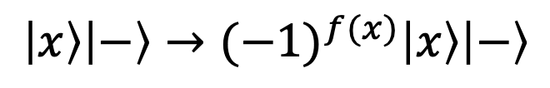
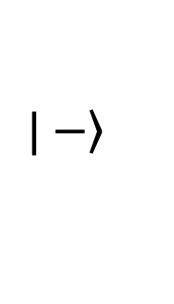
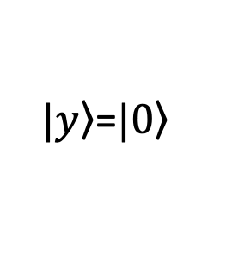
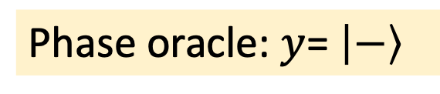
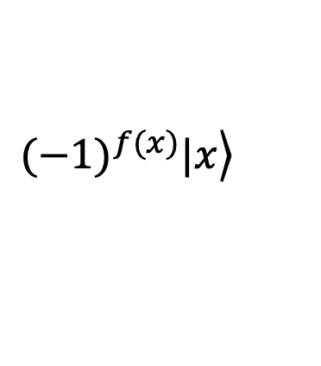
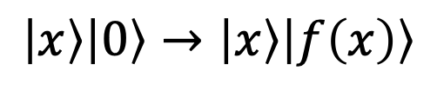
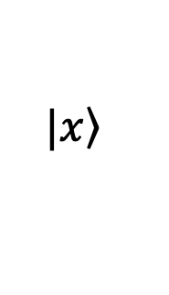
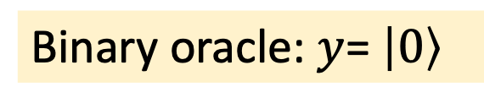





Quantum Oracle
Binary oracle: $y$= $\left|0\right\rangle$
Phase oracle: $y$= $\left|−\right\rangle$
Input
$$\left.{(−1)}^{f(x)}|x\right\rangle$$
_{f(x)}
O
$$\left.|x\right\rangle$$
$$\left.|x\right\rangle$$
$$\left.|x\right\rangle$$
$\left.|y\right\rangle$=$\left.|0\right\rangle$
$\left.|x\right\rangle$ $\left|f\left(x\right)\right\rangle$
$\left.|y\right\rangle$=$\left.|−\right\rangle$
$$\left.|−\right\rangle$$
auxiliary
(ancillary)
$$\left|x\right\rangle \left|0\right\rangle →\left|x\right\rangle \left|f\left(x\right)\right\rangle$$
$$\left|x\right\rangle \left|−\right\rangle →{(−1)}^{f(x)}\left|x\right\rangle \left|−\right\rangle$$
$$\left|x\right\rangle \left|y\right\rangle →\left|x\right\rangle \left|y⨁f\left(x\right)\right\rangle$$
Notes:
In its simplest form, an oracle acts on two registers: an input register holding an $n$-qubit state $\left.|x\right\rangle$, and a single-qubit auxiliary (target) register $\left.|y\right\rangle$.
1. Binary oracle
If the auxiliary qubit is initialized to $\left.|0\right\rangle$, the oracle evaluates the function $f\left(x\right)$. At the output, the input register$\left.|x\right\rangle$ remains unchanged, while the auxiliary qubit contains the value $f\left(x\right)$. More generally, for any auxiliary state $\left.|y\right\rangle$, the oracle transforms the state as
$$\left|x\right\rangle \left|y\right\rangle →\left|x\right\rangle \left|y⨁f\left(x\right)\right\rangle$$
2. Phase oracle
If the auxiliary qubit is initialized to the state $\left|−\right\rangle$, the same oracle can act as a phase oracle:
$$\left|x\right\rangle \left|−\right\rangle →{(−1)}^{f(x)}\left|x\right\rangle \left|−\right\rangle$$
The auxiliary qubit remains in the state $\left|−\right\rangle$, while the phase of the input register is flipped based on $f(x)$. If $f\left(x\right)=1$, the input acquires a minus sign; if $f\left(x\right)=0$, it remains unchanged.
More generally, an oracle can operate on multi-qubit input and multi-qubit auxiliary registers.
More generally, an oracle can operate on multi-qubit input and auxiliary registers.

Slide 23

Quantum
superposition
Notes:
Quantum superposition is a fundamental principle of quantum computing that allows a quantum system to exist in a combination of multiple basis states at the same time.

Slide 24



Quantum Superposition
H
Quantum circuit
$$\left.|0\right\rangle$$
H
$$\left.|0\right\rangle$$
H
$$\left.|0\right\rangle$$
Notes:
The power of quantum superposition is that it allows a quantum computer to process multiple inputs within a single quantum state. Instead of evaluating inputs one by one, a quantum circuit can represent and process all possible inputs in superposition.
A typical quantum circuit starts with all qubits in the state ∣0⟩. By applying Hadamard gates, we place them into an equal superposition of all possible input states. The circuit can then process these inputs together in a single quantum computation.

Slide 25






Single-Qubit Superposition
$$\left\{\begin{matrix}H|\left.0\right\rangle =\frac{\left.|0\right\rangle +\left.|1\right\rangle }{\sqrt{2}} \\ H|\left.1\right\rangle =\frac{\left.|0\right\rangle −\left.|1\right\rangle }{\sqrt{2}}\end{matrix}\right.$$
$$\left.|−\right\rangle =\frac{\left.|0\right\rangle −\left.|1\right\rangle }{\sqrt{2}}$$
$$|\left.q\right\rangle$$
H
$$\left.|+\right\rangle = \frac{\left.|0\right\rangle +\left.|1\right\rangle }{\sqrt{2}}$$
$$H|\left.q\right\rangle =\frac{\left|\left.0\right\rangle +{\left(−1\right)}^{q}\right|\left.1\right\rangle }{\sqrt{2}}$$
$$=\frac{1}{\sqrt{2}}\sum_{k=0}^{1}{{\left(−1\right)}^{qk}|\left.k\right\rangle \text{,} } ∀q,k∈\left\{0,1\right\}$$
Notes:
Applying a Hadamard transformation to a qubit initially in state ∣0⟩ produces the state ∣+⟩, represented by a vector pointing along the positive x-axis of the Bloch sphere. Similarly, applying the Hadamard transformation to ∣1⟩ produces ∣−⟩, pointing along the negative x-axis.
These two cases can be combined into a single expression by introducing the factor ${\left(−1\right)}^{q}$, where $q$ is either 0 or 1. This factor determines the sign of the ∣1⟩ component of the resulting state.
The expression can then be written more generally by introducing an index $k$, which also takes the values 0 and 1:
$$\frac{1}{\sqrt{2}}\sum_{k=0}^{1}{{\left(−1\right)}^{qk}|\left.k\right\rangle \text{,} }$$

Slide 26





Two-Qubit Superposition
$$|\left.q_{1}\right\rangle$$
$$H\left|\left.q_{1}\right\rangle ⨂H\right|\left.q_{2}\right\rangle =\left(\frac{1}{\sqrt{2}}\sum_{k_{1}=0}^{1}{{\left(−1\right)}^{q_{1}k_{1}}|\left.k_{1}\right\rangle }\right)⨂\left(\frac{1}{\sqrt{2}}\sum_{k_{2}=0}^{1}{{\left(−1\right)}^{q_{2}k_{2}}|\left.k_{2}\right\rangle }\right)$$
H
$$|\left.q_{2}\right\rangle$$
H
$$H^{⨂2}|\left.q_{1}q_{2}\right\rangle =\frac{1}{\sqrt{2^{2}}}\sum_{k_{1}=0}^{1}{\sum_{k_{2}=0}^{1}{{\left(−1\right)}^{q_{1}k_{1}+q_{2}k_{2}}|\left.k_{1}k_{2}\right\rangle }}$$
Example:
$$H^{⨂2}|\left.q_{1}q_{2}\right\rangle =H^{⨂2}|\left.01\right\rangle →\frac{1}{2}\left({\left(−1\right)}^{0+0}\left|\left.00\right\rangle +{\left(−1\right)}^{0+1}\right|\left.01\right\rangle +{\left(−1\right)}^{0+0}\left|\left.10\right\rangle +{\left(−1\right)}^{0+1}\right|\left.11\right\rangle \right)$$
$$\left|\left.q_{1}q_{2}\right\rangle =0.5\right|\left.00\right\rangle −0.5\left|\left.01\right\rangle +0.5\right|\left.10\right\rangle −0.5|\left.11\right\rangle$$
Notes:
For two qubits, the superposition is built by taking the Kronecker product of the two single-qubit states produced by the Hadamard gates. When we expand the product, the exponents $qk$ add together in the powers of (−1), determining the sign of each term.
The resulting basis states $|\left.k_{1}k_{2}\right\rangle$⟩ cover all four possible combinations of two bits. Each appears with the same amplitude magnitude, and the normalization factor becomes 1/2.
.

Slide 27





Multi-Qubit Superposition
$$|\left.q_{1}\right\rangle$$
$$H^{⊗n}\left|q_{1⋯}q_{n}\right\rangle =\frac{1}{\sqrt{2^{n}}}\sum_{k_{1},⋯,k_{n}=0}^{1}{{\left(−1\right)}^{{q_{1}k_{1}+⋯+q}_{n}k_{n}}\left|k_{1⋯}k_{n}\right\rangle }$$
H
$$|\left.q_{2}\right\rangle$$
H
$${{{q∙k=q}_{1}k_{1}+⋯+q}_{n}k_{n}→q}_{1}k_{1}⨁⋯q_{n}⨁k_{n}$$
$$H^{⊗n}\left|q\right\rangle =\frac{1}{\sqrt{2^{n}}}\sum_{k∈{\left\{0,1\right\}}^{n}}{{\left(−1\right)}^{q∙k}\left|k\right\rangle }$$
$$|\left.q_{n}\right\rangle$$
H
Notes:
To find the superposition state of multiple qubits, we generalize the two-qubit case to an $n$-qubit register. The result contains all $2^{n}$ computational basis states, each with the same amplitude magnitude $1/\sqrt{2^{n}}$. The only difference between the amplitudes is their sign, which is determined by the exponent ${\left(−1\right)}^{q∙k}$, where
$${{{q∙k=q}_{1}k_{1}+⋯+q}_{n}k_{n}→q}_{1}k_{1}⨁⋯q_{n}⨁k_{n}$$
This is the bitwise inner product modulo 2. If the result is 0, the amplitude is positive; if it is 1, the amplitude is negative.
So the formula has the same form as in the single-qubit case, except that the exponent now contains a bitwise inner product rather than a simple product. The Hadamard transformation produces a superposition of all possible n-bit basis states, with each state carrying a sign determined by its bitwise inner product with the initial bit string.

Slide 28
Quantum Interference
H
|0⟩
H
|0…0⟩-|0…1⟩ + … + |1…1⟩
√2^{n}
|0⟩
H
|0⟩
quantum circuit
Notes:
Quantum superposition enables another fundamental principle of quantum computing: quantum interference. Probability amplitudes associated with the same basis state can reinforce each other, called constructive interference, or cancel each other, called destructive interference.
In many quantum algorithms, qubits are initially placed in equal superposition. The algorithm then uses interference to increase the amplitude of desired states and reduce the amplitudes of unwanted states, making the correct result more likely to appear when measured.
Depending on the algorithm, quantum computation can produce different types of results:
Exact results: The correct answer is obtained with certainty.
Superpositions of results: The quantum state represents multiple possible outcomes, although each measurement returns only one.
Statistical results: Repeated measurements produce a probability distribution of possible outcomes.

Slide 29




















Example of Quantum Interference
$$\frac{1}{\sqrt{2}}\left(\left.|0\right\rangle +\left.|1\right\rangle \right)$$
$$\frac{1}{\sqrt{2}}\frac{1}{\sqrt{2}}\left(\left.|0\right\rangle +\left.|1\right\rangle +\left.|0\right\rangle −\left.|1\right\rangle \right)$$
$$=\left.|0\right\rangle$$
$$|\left.0\right\rangle$$
U(π/2,0, π)
H
$$1$$
$$1$$
$$1$$
$$1$$
$$=$$
$$\left|0\right\rangle$$
$$\left|1\right\rangle$$
$$\left|0\right\rangle$$
$$\left|1\right\rangle$$
$$\left|0\right\rangle$$
$$\left|1\right\rangle$$
$$\left|0\right\rangle$$
$$\left|1\right\rangle$$
$$−1$$
$$−1$$
$$−1$$
$$−1$$
Notes:
To illustrate the principle of quantum interference, consider a qubit initially prepared in the state ∣0⟩.
After applying a Hadamard gate, the qubit enters a superposition of ∣0⟩ and ∣1⟩.
Next, a U gate modifies the amplitudes, introducing a negative sign into one component and causing them to interfere. The amplitudes leading to ∣0⟩ reinforce each other, while those leading to ∣1⟩ cancel.
As a result, the final state is ∣0⟩.
In this simple example, the U gate controls the interference pattern and therefore the final outcome. In a real quantum algorithm, this part could represent a much more complex sequence of operations designed to increase the probability of desired results and suppress unwanted ones. For example, a quantum model could be used to predict whether it will rain. It could process inputs such as temperature, humidity, and pressure and use quantum interference to make one of the two possible answers more likely.

Slide 30
Phase Kickback
Notes:
Phase kickback is a mechanism used in many quantum algorithms to encode information into the phase of a qubit. This phase information can then be used through quantum interference to influence the final measurement.

Slide 31









MathBox: Eigenvalues and Eigenvectors
eigenvalue equation
$$λy$$
$$A\left|x\right\rangle =λ\left|x\right\rangle$$
$$A\left|x\right\rangle =λ\left|x\right\rangle$$
$λ$. : eigenvalue
$\left|x\right\rangle$: eigenvector
$$y$$
$$\left|x\right\rangle$$
Example:
$$x$$
$$λx$$
$I\left|x\right\rangle =\left(\begin{matrix}1 & 0 \\ 0 & 1\end{matrix}\right)\left(\begin{matrix}x \\ y\end{matrix}\right)=\left(\begin{matrix}x \\ y\end{matrix}\right)=\left|x\right\rangle ⇒λ$=1
Notes:
To better understand how phase information is encoded in quantum algorithms, it is useful to introduce the concepts of eigenvalues and eigenvectors. The German word eigen means “own,” “proper,” or “characteristic,” depending on context.
If an operator $A$ acts on a nonzero vector ∣x⟩ and simply scales it by a factor $λ$ without changing its direction, then $λ$ is called an eigenvalue, and $\left|x\right\rangle$ is called an eigenvector of $A$. In simple terms, applying the operator to an eigenvector has the same effect as multiplying that vector by a scalar. This is expressed by the eigenvalue equation
$$A\left|x\right\rangle =λ\left|x\right\rangle$$
For example, applying the identity operator $I$ to any vector $\left|x\right\rangle$ gives the same vector:
$I\left|x\right\rangle =\left|x\right\rangle$. Therefore, the eigenvalue is $λ$=1, and every nonzero vector is an eigenvector of the identity operator.
When a unitary operator is applied to one of its eigenstates, the state itself remains unchanged, but it picks up a phase determined by the eigenvalue. This allows us to extract information about the operator without changing the eigenstate.

Slide 32





Phase Kickback
$$\left.|c\right\rangle$$
$$e^{iφ}$$
eigenvalue
eigenvector
$V\left.|v\right\rangle =e^{iφ}$ $\left.|v\right\rangle$
$$\left.|v\right\rangle$$
$$V(φ)$$
Notes:
Phase kickback gets its name from the fact that, in a controlled-$V$ operation, a phase associated with the target state can appear on the control qubit. If an operator $V$ has an eigenstate (i.e. eigenvector) $\left.|v\right\rangle$ with eigenvalue $e^{iφ}$, then applying controlled-$V$ causes the phase factor $e^{iφ}$ to appear on the ∣1⟩ component of the control qubit, provided the target is in the eigenstate $\left.|v\right\rangle$.
The control qubit should be in superposition for this phase to have an observable effect. If the control is ∣0⟩, $V$ is not applied and no kickback occurs. If the control qubit is in the state |1⟩, both qubits will acquire a phase, resulting in a global phase for the system that is physically unmeasurable. Therefore, phase kickback is effective and measurable only when the control qubit is in a state of superposition.

Slide 33



















Phase Kickback Example
$$z$$
$$\left.|0\right\rangle$$
$$q_{0}$$
$$\left.|+\right\rangle$$
$$y$$
$$\left.|+\right\rangle$$
$$φ=\frac{π}{4}$$
$$\begin{matrix}\left.|S_{2}\right\rangle = & \frac{\left.|01\right\rangle +e^{iφ}\left.|11\right\rangle }{\sqrt{2}} \\ = & \frac{\left.|0\right\rangle +e^{iφ}\left.|1\right\rangle }{\sqrt{2}}\left.|1\right\rangle \end{matrix}$$
$$x$$
$$\left.|S_{1}\right\rangle =\frac{\left.|01\right\rangle +\left.|11\right\rangle }{\sqrt{2}}$$
$$\left.|1\right\rangle$$
$$z$$
$$q_{1}$$
$$\left.|0\right\rangle$$
$$P\left(φ\right)$$
$$\left.|1\right\rangle$$
$$y$$
$$P\left(φ\right)=\left(\begin{matrix}1 & 0 \\ 0 & e^{iφ}\end{matrix}\right), \left\{\begin{matrix}\left.|1\right\rangle & \text{eigenstate} \\ e^{iφ} & \text{eigenvalue}\end{matrix}\right.$$
$$x$$
$$\left.|1\right\rangle$$
Notes:
The image illustrates phase kickback using a controlled-phase gate $P\left(φ\right)$.
The upper qubit is in the superposition state $\left.|+\right\rangle$, while the lower qubit is in state $\left.|1\right\rangle$, which is an eigenstate of the $P\left(φ\right)$ operator with eigenvalue $e^{iφ}$.
At the input to the controlled-P gate, the state of the circuit is described by the Kronecker product of these two qubit states.
After applying the controlled-P gate, the phase factor $e^{iφ}$ appears on the $\left.|1\right\rangle$ component of the control qubit, while the target qubit remains unchanged. This is the phase kickback.
We can visualize the result using two Bloch spheres. The upper, control qubit rotates around the z-axis by an angle $φ$, for example $φ=π/4$, while the lower, target qubit remains in its original state $\left.|1\right\rangle$.

Slide 34



Quantum entanglement
Notes:
Quantum entanglement occurs when two or more qubits share a combined quantum state that cannot be described independently. Their measurement outcomes can then be strongly correlated, so measuring one can immediately tell us something about the other, even when the qubits are far apart.

Slide 35








Creating Quantum Entanglement
from qiskit import *
qc = QuantumCircuit(2, 2)
qc.h(0)
qc.cx(0, 1)
qc.measure([0,1], [0,1])
$$\left.|0\right\rangle$$
H
$$q_{0}$$
$$\frac{\left.|00\right\rangle +\left.|10\right\rangle }{\sqrt{2}}$$
$$\frac{\left.|00\right\rangle +\left.|11\right\rangle }{\sqrt{2}}$$
$$q_{1}$$
$$\left.|0\right\rangle$$
+
$$c_{0}$$
$$c_{1}$$
Notes:
Qubits can be entangled using the circuit shown in the image, often called a Bell circuit, named after physicist John Bell.
First, the upper qubit is placed in superposition using a Hadamard gate.
Next, a CNOT gate is applied. If the upper qubit is ∣1⟩, the lower qubit is flipped to ∣1⟩. This creates an entangled state in which the two qubits can no longer be described independently.
The listing shows a Python program that generates the entangled state, together with a histogram of the measurement results. The histogram clearly shows that the qubits are correlated: on an ideal simulator, the result is either 00 or 11. These two outcomes occur with equal probability, so each individual measurement is random, with a 50%−50% probability distribution.

Slide 36







Transforming Bell States
$$\left.|0\right\rangle$$
$$\left.|0\right\rangle$$
H
H
+
$$\left.|B_{00}\right\rangle =\frac{\left.|00\right\rangle +\left.|11\right\rangle }{\sqrt{2}}$$
$$\left.|B_{01}\right\rangle =\frac{\left.|01\right\rangle +\left.|10\right\rangle }{\sqrt{2}}$$
$$\left.|0\right\rangle$$
$$\left.|0\right\rangle$$
+
+
$$\left.|0\right\rangle$$
$$\left.|0\right\rangle$$
H
Z
H
+
Z
$$\left.|B_{10}\right\rangle =\frac{\left.|00\right\rangle −\left.|11\right\rangle }{\sqrt{2}}$$
$$\left.|B_{11}\right\rangle =\frac{\left.|01\right\rangle −\left.|10\right\rangle }{\sqrt{2}}$$
$$\left.|0\right\rangle$$
$$\left.|0\right\rangle$$
+
+
Notes:
It is often useful to transform one Bell state into another. Starting with the standard Bell state $\left.|B_{00}\right\rangle$, applying Pauli gates to one qubit of the entangled pair can transform it into any of the other Bell states:
Applying the Pauli-X gate gives $\left.|B_{01}\right\rangle$.
Applying the Pauli-Z gate gives $\left.|B_{10}\right\rangle$.
Applying both the Pauli-X and Pauli-Z gates gives$\left.|B_{11}\right\rangle$
Note that the terms are usually written in the standard order, so $\left.|B_{01}\right\rangle =\frac{\left.|10\right\rangle +\left.|01\right\rangle }{\sqrt{2}}$ is written as $\left.|B_{01}\right\rangle =\frac{\left.|01\right\rangle +\left.|10\right\rangle }{\sqrt{2}}$. When the Z gate introduces a minus sign, the state is written so that the minus sign appears as the relative phase between the two terms.

Slide 37




Bell-State Measurement Correlations
$$\left.|Φ^{+}\right\rangle =\left.|B_{00}\right\rangle =\frac{\left.|00\right\rangle +\left.|11\right\rangle }{\sqrt{2}}$$
00
11
$$\left.\left.|Φ^{−}\right\rangle =|B_{10}\right\rangle =\frac{\left.|00\right\rangle −\left.|11\right\rangle }{\sqrt{2}}$$
00
11
$$\left.\left.|Ψ^{+}\right\rangle =|B_{01}\right\rangle =\frac{\left.|01\right\rangle +\left.|10\right\rangle }{\sqrt{2}}$$
01
10
$$\left.\left.|Ψ^{−}\right\rangle =|B_{11}\right\rangle =\frac{\left.|01\right\rangle −\left.|10\right\rangle }{\sqrt{2}}$$
01
10
Notes:
As shown earlier, measuring $\left.|B_{00}\right\rangle$⟩ or $\left.|B_{10}\right\rangle$ produces correlated outcomes: either 00 or 11.
Measuring $\left.|B_{01}\right\rangle$ or $\left.|B_{11}\right\rangle$ produces anti-correlated outcomes: either 01 or 10.
The relative phase distinguishes the Bell states but does not change these computational-basis measurement correlations.
These correlations are an important resource in quantum computing and are used in many quantum algorithms, communication protocols, and other quantum applications.

Slide 38
Measurement in the Bell basis
$$\left.|0\right\rangle$$
H
$$\left.|0\right\rangle$$
H
$$\left.|B_{00}\right\rangle$$
$$\left.|{B′}_{00}\right\rangle$$
$$\left.|{B′′}_{00}\right\rangle$$
$$\left.|0\right\rangle$$
+
+
$$\left.|0\right\rangle$$
$$\left.|B_{00}\right\rangle =\frac{\left.|00\right\rangle +\left.|11\right\rangle }{\sqrt{2}}$$
$$\left.|{B′}_{00}\right\rangle =\frac{\left.|00\right\rangle +\left.|10\right\rangle }{\sqrt{2}}$$
$$\left.|{B′′}_{00}\right\rangle =\frac{1}{\sqrt{2}}\left[\frac{\left.|0\right\rangle +\left.|1\right\rangle }{\sqrt{2}}+\frac{\left.|0\right\rangle −\left.|1\right\rangle }{\sqrt{2}}\right]\left.|0\right\rangle =\left.|00\right\rangle$$
$$\underset{→}{CX}$$
$$\underset{→}{H}$$
Notes:
Bell-state measurement allows us to distinguish between the four Bell states. Since quantum gates are reversible, we apply the Bell-state preparation circuit in reverse: first a CNOT gate, followed by a Hadamard gate.
These operations transform the Bell states into computational basis states, where quantum interference plays an important role. Measuring the two qubits then produces a unique result—00, 01, 10, or 11—that identifies the original Bell state.
This process is called measurement in the Bell basis.

Slide 39



Entangling Multiple Qubits: GHZ States
$$\left.|0\right\rangle$$
H
$$\left.|0\right\rangle$$
+
$$\begin{matrix}\left.|{GHZ}_{3}\right\rangle = & \frac{\left.|000\right\rangle +\left.|111\right\rangle }{\sqrt{2}} \\ \left.|{GHZ}_{4}\right\rangle = & \frac{\left.|0000\right\rangle +\left.|1111\right\rangle }{\sqrt{2}} \\ ⋮ & ⋮ \\ \left.|{GHZ}_{n}\right\rangle = & \frac{{\left.|0\right\rangle }^{⨂n}+{\left.|1\right\rangle }^{⨂n}}{\sqrt{2}}\end{matrix}$$
$$\left.|0\right\rangle$$
+
$$\left.|0\right\rangle$$
$$\left.|0\right\rangle$$
+
Notes:
Entanglement can be extended to three or more qubits, producing multi-qubit entangled states such as the GHZ state.
For three qubits,
$$\left.|{GHZ}_{3}\right\rangle =\frac{\left.|000\right\rangle +\left.|111\right\rangle }{\sqrt{2}}$$
GHZ states exhibit strong correlations across multiple qubits and are an important resource in quantum computing. They are used in areas such as quantum algorithms, error correction, distributed quantum computing, and quantum communication.

Slide 40
Quantum
measurement
Notes:
Quantum measurement is the final step in most quantum algorithms, where quantum information is converted into a classical result. It allows the information produced by quantum computation to be extracted and used for further processing.

Slide 41







QM Box: Observable
mathematical model
physical system
$$λ_{1}=1$$
polarized photon
$$\left|0\right\rangle$$
$$bit 0$$
$$\left|→\right\rangle , +1$$
$$\left|1\right\rangle$$
$$\left| ↑ \right\rangle , −1$$
$$\left|S\right\rangle$$
$$bit 1$$
$$Z=\left(\begin{matrix}1 & 0 \\ 0 & −1\end{matrix}\right)$$
detector
$$λ_{2}=−1$$
Notes:
In quantum mechanics, measurement is described using observables.
A physical observable is a measurable property of a quantum system, such as photon polarization, energy, or spin.
A mathematical observable is represented by a Hermitian operator. Its eigenvalues represent the possible measurement outcomes, while its eigenvectors correspond to the states associated with those outcomes. Its expectation value gives the statistical average obtained over many identical measurements.
The term observable is commonly used for both the physical quantity and its mathematical representation, with the meaning determined by context.
Example:
From a hardware perspective, measuring a qubit means measuring a physical property of the system used to represent it, such as the polarization of a photon.
A diagonally polarized photon (figure left) can be represented as a superposition of horizontal and vertical polarization states. When its polarization is measured in the horizontal–vertical basis, the photon is detected as either horizontal or vertical, which can be assigned the measurement values +1 and −1, respectively.
Mathematically (figure right), horizontal and vertical polarization are represented by the basis states ∣0⟩ and ∣1⟩, while diagonal polarization is their superposition.
Suppose the photon state is ∣S⟩ and the measurement observable is the Pauli-Z operator. Its eigenstates are ∣0⟩ and ∣1⟩, with eigenvalues +1 and −1, respectively. The measurement therefore produces one of these eigenvalues and leaves the qubit in the corresponding eigenstate.
In a quantum computer, these two outcomes are typically reported as the classical bits 0 and 1.
If a different observable is measured, its eigenstates define a different measurement basis and can therefore produce different measurement probabilities and outcomes.

Slide 42










Pauli Measurements
$$z$$
$$\left|1\right\rangle$$
measurement | eigenstate | operator->Z
Pauli Z | $$\{\left|0\right\rangle ,\left|1\right\rangle \}$$
Pauli X | $$\{\left|+\right\rangle ,\left|−\right\rangle \}$$ | $$H$$
Pauli Y | $$\{\left|+i\right\rangle ,\left|−i\right\rangle \}$$ | $$HS^{†}$$
$$\left|−i\right\rangle$$
$$\left|−\right\rangle$$
$$\left|+\right\rangle$$
$$\left|+i\right\rangle$$
$$y$$
$$x$$
$$\left|0\right\rangle$$
Notes:
In the standard circuit model, measurement is typically performed in the computational (Z) basis, along the z-axis. In this case, the observable is the Pauli-Z operator. The possible measurement outcomes are its eigenvalues +1 and −1, while the qubit is left in the corresponding eigenstate ∣0⟩ or ∣1⟩. These outcomes are typically mapped to the classical bits 0 and 1.
More generally, Pauli measurements refer to measurements along the x-, y-, or z-axis, represented by the corresponding Pauli operators X, Y, and Z. Each measurement has two possible eigenstates, corresponding to the eigenvalues +1 and −1, as shown in the table.
To measure in another basis, we first apply appropriate gates to transform that basis into the computational basis and then perform the standard measurement. The table in the third column shows the operations used for measurements in the computational, diagonal, and circular bases.
In all cases, the measurement result is typically reported as a classical bit, 0 or 1, while the post-measurement state depends on the chosen measurement basis.

Slide 43








Why Z-measurement does not reveal phase
$$z$$
$$\left.|0\right\rangle$$
0.5
0.5
$$θ=\frac{π}{2}$$
$$y$$
0 1
$$φ=\frac{π}{3}$$
$$x$$
$$\left.|S\right\rangle =\frac{\left.|0\right\rangle +\left.e^{iπ/3}|1\right\rangle }{\sqrt{2}}$$
0
1
$$\left.|1\right\rangle$$
Notes:
The example illustrates the measurement of a qubit along the z-axis. Suppose the qubit is initialized in the state
$$\left.|S\right\rangle =\frac{\left.|0\right\rangle +\left.e^{iπ/3}|1\right\rangle }{\sqrt{2}}$$
On the Bloch sphere, the vector lies on the equator, with polar angle$θ =π/2$ and phase angle $φ =π/3$.
When measured in the Z basis, the qubit collapses to either ∣0⟩ or ∣1⟩, each with a 50% probability, producing the classical bit 0 or 1. Repeated measurements produce the histogram shown in the figure, with approximately equal counts for the two outcomes.
Notice that the histogram contains no information about the relative phase. In other words, measurement in the Z basis cannot directly reveal the qubit’s phase.

Slide 44






X-Basis Measurement
$$z$$
$$\left.|0\right\rangle$$
0.75
$$\left.|S′\right\rangle =H\left.|S\right\rangle$$
$$θ′=\frac{π}{3}$$
H
$$φ^{′}=−\frac{π}{2}$$
$$y$$
0.25
0 1
$$x$$
$$\left.|S\right\rangle$$
0
1
$$\left.|1\right\rangle$$
Notes:
The qubit is prepared in the same state as in the previous example. Since the standard measurement is performed in the Z basis, to measure the qubit in the X basis we first apply a Hadamard (H) gate. This transforms the X basis into the computational basis before measurement. We rotate the state so that the phase information contained in the x-component is converted into a new z-component, which the standard measurement can detect.
For a general Bloch state,
$$x=\sin{θ\cos{φ, }}y=\sin{θ\sin{φ}, z=\cos{θ}}$$
After the Hadamard,
$$z^{′}=x=\sin{θ\cos{φ, }}$$
Since $z^{′}=\cos{θ′⇒}\cos{θ^{′}=}\sin{θ\cos{φ }}$
The Hadamard gate can be viewed as a 180° rotation about an axis halfway between the positive x- and z-axes. For the initial state $θ =π/2$ and $φ=π/3$​, this rotation moves the Bloch vector from the xy-plane into the yz-plane.
After the Hadamard gate, the state has $θ′ =π/3$ and $φ′={−π}/2$. In this way, information about the original X-component is converted into a z-component that can be detected by the standard measurement. The histogram therefore gives approximately 75% for 0 and 25% for 1.
Although the physical measurement is performed in the Z basis, we interpret it as an X-basis measurement of the original state. A measured 0 corresponds to $\left.|+\right\rangle$, while a measured 1 corresponds to $\left.|−\right\rangle$.

Slide 45





Y-Basis Measurement
0.93
$$z$$
$$\left.|0\right\rangle$$
$$\left.|S′\right\rangle =H\left.S^{†}|S′\right\rangle$$
$$θ′=\frac{π}{6}$$
$$φ^{′}=\frac{π}{2}$$
$$S^{†}$$
H
$$y$$
0 1
0.67
$$x$$
$$\left.|S\right\rangle$$
0
1
$$\left.|1\right\rangle$$
Notes:
The qubit is prepared in the same state as in the previous examples. Since the standard measurement is performed in the Z basis, to measure the qubit in the Y basis we first apply an S† gate followed by a Hadamard (H) gate. Together, these gates transform the Y basis into the computational basis before measurement. We rotate the state so that the phase information contained in the y-component is converted into a new z-component, which the standard measurement can detect.
We rotate the state so that the phase information contained in the y-component is converted into a new z-component, which the standard measurement can detect.
For a general Bloch state,
$$x=\sin{θ\cos{φ, }}y=\sin{θ\sin{φ}, z=\cos{θ}}$$
After applying the S†-H sequence,,
$$z^{′}=y=\sin{θ\sin{φ, }}$$
Since $z^{′}=\cos{θ′⇒}\cos{θ^{′}=}\sin{θ\sin{φ }}$
The S† gate first rotates the Bloch vector by ${−π}/2$ around the z-axis. The phase angle therefore changes from $φ =π/3$ to $φ ={−π}/6$​, while the vector remains on the equator. The Hadamard gate can then be viewed as a 180° rotation about an axis halfway between the positive x- and z-axes. In this example, it moves the vector from the xy-plane into the yz-plane.
After the S†-H sequence, the state has $θ′ =π/6$ and $φ′=π/2$. In this way, information about the original Y-component is converted into a z-component that can be detected by the standard measurement. The histogram therefore gives approximately 93% for 0 and 7% for 1.
Although the physical measurement is performed in the Z basis, we interpret it as a Y-basis measurement of the original state. A measured 0 corresponds to $\left.|+i\right\rangle$, while a measured 1 corresponds to $\left.|−i\right\rangle$.

Slide 46
Implicit Measurement
H
Y
+
Z
≈
A qubit that is not explicitly measured is automatically measured at the end of a quantum circuit.
Notes:
Implicit measurement means that a qubit that is no longer used in a computation can be treated as if it had been measured, with the measurement result ignored. This does not affect the measurement statistics of the remaining qubits.
In the example shown in the figure, the bottom qubit can therefore be considered implicitly measured. From a practical standpoint, we do not need to explicitly measure every qubit in a circuit. If we only care about the results of certain qubits, we can measure those and leave the others unmeasured.

Slide 47
Deferred measurement
Measurements can often be deferred until the end of a quantum circuit without changing the final measurement results.
Notes:
The principle of deferred measurement states that, under appropriate conditions, measurements performed within a quantum circuit can be postponed until the end without changing the relevant measurement statistics.
For example, in the first circuit, qubit q[0] is measured, and the classical result determines whether a Hadamard gate is applied to qubit q[1]. The circuit then continues with the remaining operations, represented by $f$.
In the second circuit, the measurement and classically controlled Hadamard are replaced by a controlled-Hadamard gate, and the measurement of q[0] is postponed until the end. This keeps q[0] unmeasured during the computation, allowing it to participate in later quantum operations if needed.

Slide 48
Quantum Fourier Transform
+
=
Joseph Fourier
(1768-1830)
Notes:
The Quantum Fourier Transform is a tool that reveals hidden phase information and patterns that are difficult to see directly in a quantum state.
The Fourier transform is named after the French mathematician Joseph Fourier, best known for his work on Fourier series, which represent periodic functions as sums of sine and cosine waves. His work laid the foundation for the later development of the Fourier transform.
Typically, the Quantum Fourier Transform (QFT) is used as a subroutine in more complex quantum algorithms.

Slide 49

Understanding the Fourier Transform
DFT
amplitude (loudness)
time domain
frequency (pitch)
The Discrete Fourier Transform (DFT) converts a finite sequence of sampled data into a discrete set of frequency components.
Notes:
The Fourier transform can be illustrated with a simple example using an audio signal. Imagine a pianist playing three notes at the same time. The sound we hear is a complex waveform that changes over time, so it is represented in the time domain.
To analyze this signal, samples are taken at regular intervals from the electrical signal produced by a microphone.
When the Discrete Fourier Transform (DFT) is applied to these samples, the signal is transformed from the time domain to the frequency domain. Here, the horizontal axis represents frequency, which corresponds to pitch, while the vertical axis represents amplitude, which corresponds to the strength or loudness of each frequency component.
This representation shows that the original signal can be expressed as a combination of sinusoidal components, each with its own frequency and amplitude. The inverse DFT (IDFT) performs the opposite transformation, reconstructing the time-domain signal from its frequency components.
More generally, the DFT transforms a sequence of data values into a set of Fourier coefficients, which reveal periodic patterns that may be hidden in the original data.

Slide 50
Applications of Fourier Transform
Notes:
The applications of the Fourier transform are vast, appearing in areas such as digital signal processing, audio and video compression, number theory, cryptography, statistics, probability theory, and astrophysics.
One important application of the Discrete Fourier Transform (DFT) is in speech processing and recognition. Audio signals can be transformed into the frequency domain, where frequency patterns can be extracted and used by machine-learning models.
Fourier analysis can also be used to study activity in social networks. For example, the number of posts, messages, or interactions can be recorded over time. Applying the DFT can reveal periodic patterns, such as daily or weekly cycles in user activity.
Another major application is medical imaging. In magnetic resonance imaging (MRI), the measured data are collected in a spatial-frequency representation known as k-space. Fourier transformation is then used to reconstruct this data into an image that can be interpreted by doctors.

Slide 51



















MathBox: Phase Factor
$$Im$$
$$i$$
$$e^{±iφ}=\cos{φ}±i\sin{φ}$$
$φ$ : phase angle
$e≈2.71$: Euler’s number
$e^{±iφ}$ : phase factor
$$e^{iφ}$$
$$i\sin{φ}$$
Leonhard Euler
(1707-1783)
$$φ$$
O
$$\cos{φ}$$
$$Re$$
$$1$$
$$i$$
$$i$$
$${{× e}^{i\frac{π}{6}} }_{}$$
$$e^{i\frac{π}{6}}z_{1}$$
$$i/2$$
$$z_{1}$$
$$φ=π/6$$
O
$$1$$
O
$$1$$
Notes:
A key concept in the Quantum Fourier Transform is the phase factor. A phase factor is a complex number that lies on the unit circle and can be written using Euler’s formula:
$$e^{iφ}=\cos{φ}+i\sin{φ}$$
Here, $\cos{φ}$gives the horizontal coordinate and $\sin{φ}$ gives the vertical coordinate in the complex plane. Since the magnitude of $e^{iφ}$ is always 1, multiplying a complex amplitude by a phase factor rotates it without changing its magnitude. The angle of rotation is $φ$.
For example, multiplying by $e^{iπ/6}$ rotates a complex amplitude by $π/6$while keeping its magnitude unchanged.
In quantum computing, these phase relationships between amplitudes are important because they determine how amplitudes interfere.

Slide 52












MathBox: Phase Factors as n-th Roots of Unity
n-th roots of unity: evenly spaced phase factors on the unit circle:
$$e^{\frac{2πi}{n}k}=cos{\frac{2πk}{n}+i\sin{\frac{2πk}{n}}}=ω_{n}^{k}, k=\left\{0,1,⋯,n−1\right\}$$
$$i$$
$$ω_{5}^{1}$$
$$\begin{matrix}ω_{5}^{0} & = & \cos{\frac{2π×0}{5}+i\sin{\frac{2π×0}{5}}} & = & 1 \\ ω_{5}^{1} & = & \cos{\frac{2π×1}{5}+i\sin{\frac{2π×1}{5}}} & = & 0.309+i 0.951 \\ ω_{5}^{2} & = & \cos{\frac{2π×2}{5}+i\sin{\frac{2π×2}{5}}} & = & −0.809+i 0.587 \\ ω_{5}^{3} & = & \cos{\frac{2π×3}{5}+i\sin{\frac{2π×3}{5}}} & = & −0.809−i 0.587 \\ ω_{5}^{4} & = & \cos{\frac{2π×4}{5}+i\sin{\frac{2π×4}{5}}} & = & 0.309−i 0.951\end{matrix}$$
$$ω_{5}^{2}$$
$$2π/5$$
$$Re$$
$$−1$$
$$1$$
$$ω_{5}^{3}$$
$$−i$$
$$ω_{5}^{4}$$
Notes:
The unit circle can be divided into any number of equal parts. If it is divided into $n$ equal parts, the angle between two neighboring points is $2π/n$. Starting from an angle of zero and moving around the circle in these equal steps gives the angles
$$φ={2πk}/n, k=0,1,…,n−1$$
The corresponding phase factors are
$$ω^{k}=e^{{2πik}/n}, k=0,1,…,n−1$$
These form $n$ equally spaced points on the unit circle and are called the n-th roots of unity.
In other words,
Every $n$-th root of unity is a phase factor whose angle is a multiple of ${2π}/n$.
The roots correspond to $n$ equally spaced positions on the unit circle:
$ω^{0}$ starting position.
$ω^{1}$ one step of ${2π}/n$ along the circle.
$ω^{2}$ two steps of ${2π}/n$, along the circle
…
$ω^{n−1}$ the final position before returning to the starting point.
where $ω^{n}=e^{2πi}=1=ω^{0}$ is the starting point.

Slide 53



Discrete Fourier Transform (DFT)
$$k=0,1,⋯,N−1$$
$$x=\left(\begin{matrix}x_{0} \\ x_{1} \\ ⋮ \\ x_{N−1}\end{matrix}\right)⟼\tilde{x}=\left(\begin{matrix}{\tilde{x}}_{0}=\sum_{j=0}^{N−1}{x_{j}{ e}^{\frac{2πi}{N}j∙0} } \\ {\tilde{x}}_{1}=\sum_{j=0}^{n−1}{x_{j}{ e}^{\frac{2πi}{N}j∙1} } \\ ⋮ \\ {\tilde{x}}_{N−1}=\sum_{j=0}^{n−1}{x_{j}{ e}^{\frac{2πi}{N}j∙(N−1)} }\end{matrix}\right)$$
. . .
(1)
. . .
$$x=\left(\begin{matrix}x_{0} \\ x_{1} \\ ⋮ \\ x_{N−1}\end{matrix}\right)⟼\tilde{x}=\left(\begin{matrix}{\tilde{x}}_{0} \\ {\tilde{x}}_{1} \\ ⋮ \\ {\tilde{x}}_{N−1}\end{matrix}\right), {\tilde{ x}}_{k}=\sum_{j=0}^{n−1}{x_{j}ω_{}^{jk}, \left\{\begin{matrix}{ ω_{}=e}^{\frac{2πi}{N}}. \\ k=0,1⋯n−1\end{matrix}\right. }$$
(2)
Notes:
The Discrete Fourier Transform (DFT) takes a vector $x$ of length $n$ and transforms it into a new vector $\tilde{x}$. Each component of the output vector is obtained by adding all components of the original vector, after each has been rotated in the complex plane by a phase determined by a root of unity ${ω=e}^{{2πi}/N}$.
$${\tilde{ x}}_{k}=\sum_{j=0}^{n−1}{x_{j}ω_{}^{jk} }$$
The roots of unity act as phase factors, rotating the input components in the complex plane. Each successive power of $ω$ corresponds to an additional rotation of ${2π}/N$. As the frequency index $k$ increases, the phase changes more rapidly with the input index $j$, corresponding to higher frequencies.
For example,
The first component ${\tilde{x}}_{0}$ corresponds to $k=0$. It is a weighted sum of all components of the original vector, with each component $x_{j}$ multiplied by $e^{{(2πi}/{N) jk}}$, where $j$ is the index of the component. Since $k=0$, the exponential term becomes $e^{{(2πi}/{N) j∙0}}=1$ for every $j$. Therefore, ${\tilde{x}}_{0}=x_{0}+{⋯+x}_{N−1}$. So, ${\tilde{x}}_{0}$​ is simply the sum of all components of the original vector.
The second component, ${\tilde{x}}_{1}$ corresponds to $k=1$. Again, it is a weighted sum of all components of the original vector, but now the weights are $1, e^{{(2πi}/{N) }},e^{2{(2πi}/{N) }},⋯$ Thus, ${\tilde{x}}_{1}=x_{0}+x_{1}e^{{(2πi}/{N) }}+x_{2}e^{2{(2πi}/{N) }}+⋯$ In other words, ${\tilde{x}}_{1}$ is formed by summing the original vector components after each has been multiplied by a phase factor corresponding to successive rotations around the unit circle in increments of ${(2π}/{N) }$.
By replacing the $N$-th root of unity $e^{2πi/N}$ with the symbol $ω$, the $k$-th component of the transformed vector can be written compactly as
$${\tilde{ x}}_{k}=\sum_{j=0}^{n−1}{x_{j}ω_{}^{jk}, } {ω=e}^{2πi/N}$$
Here $ω$ represents a fixed rotation step around the unit circle, while its powers determine the phase factor applied to each component.

Slide 54


DFT matrix
$$F_{N}=\frac{1}{\sqrt{N}} \left(\begin{matrix}1 & 1 & 1 & 1 & ⋯ & 1 \\ 1 & ω & ω^{2} & ω^{3} & ⋯ & ω^{N−1} \\ 1 & ω^{2} & ω^{4} & ω^{6} & ⋯ & ω^{2(N−1)} \\ 1 & ω^{3} & ω^{6} & ω^{9} & ⋯ & ω^{3(N−1)} \\ ⋮ & ⋮ & ⋮ & ⋮ & ⋱ & ⋮ \\ 1 & ω^{N−1} & ω^{2(N−1)} & ω^{3(N−1)} & ⋯ & ω^{(N−1)(N−1)}\end{matrix}\right), {e^{\frac{2πi}{N}jk}=ω}^{jk}\left\{\begin{matrix}j=column \\ k=row \end{matrix}\right.$$
Example (N=4)
$$F_{N}x=\frac{1}{\sqrt{4}} \left(\begin{matrix}1 & 1 & 1 & 1 \\ 1 & ω & ω^{2} & ω^{3} \\ 1 & ω^{2} & ω^{4} & ω^{6} \\ 1 & ω^{3} & ω^{6} & ω^{9}\end{matrix}\right)\left(\begin{matrix}x_{0} \\ x_{1} \\ x_{2} \\ x_{3}\end{matrix}\right)=\frac{1}{2}\left(\begin{matrix}1 & 1 & 1 & 1 \\ 1 & i & −1 & −i \\ 1 & −1 & 1 & −1 \\ 1 & −i & −1 & i\end{matrix}\right)\left(\begin{matrix}x_{0} \\ x_{1} \\ x_{2} \\ x_{3}\end{matrix}\right)=\frac{1}{2}\left(\begin{matrix}x_{0}+x_{1}+x_{2}+x_{3} \\ x_{0}+{ix}_{1}−x_{2}−ix_{3} \\ x_{0}−x_{1}+x_{2}−x_{3} \\ x_{0}−ix_{1}−x_{2}+ix_{3}\end{matrix}\right)$$
Notes:
The Discrete Fourier Transform (DFT) can be represented as a matrix. This matrix is built from the N-th root of unity, ${ω=e}^{{2πi}/N}$. Each entry of the matrix is a power of $ω$. The element in column $j$ and row $k$ is $ω^{jk}$ , where $j$ and $k$ start from 0.
The factor $1/\sqrt{N}$, is included to make the DFT matrix unitary, meaning that it preserves the length of the vector. The DFT of a vector is then calculated simply by multiplying the DFT matrix by the original vector: $\tilde{x}=F_{N}x$.
For example, if the vector $x$ has four elements, we use a 4×4 DFT matrix. In this case, ${ω=e}^{{2πi}/4}=i$ and
$$F_{4}=\frac{1}{\sqrt{N}}\left(\begin{matrix}1 & 1 & 1 & 1 \\ 1 & ω & ω^{2} & ω^{3} \\ 1 & ω^{2} & ω^{4} & ω^{6} \\ 1 & ω^{3} & ω^{6} & ω^{9}\end{matrix}\right)=\frac{1}{2}\left(\begin{matrix}1 & 1 & 1 & 1 \\ 1 & i & −1 & −i \\ 1 & −1 & 1 & −1 \\ 1 & −i & −1 & i\end{matrix}\right)$$
Multiplying this matrix by the original vector $x$ gives the transformed vector $\tilde{x}=F_{4}x$.

Slide 55



Quantum Fourier Transform and Inverse Quantum Fourier Transform
$$|\left.x\right\rangle =\sum_{k=0}^{N−1}{x_{k}|\left.k\right\rangle \underset{→}{QFT}}\left\{\begin{aligned}|\left.\tilde{x}\right\rangle =\sum_{k=0}^{N−1}{y_{k}|\left.k\right\rangle } where { y}_{k}=\frac{1}{\sqrt{N}}\sum_{n=0}^{N−1}{x_{n}ω^{nk}} \\ ω=e^{\frac{2πi}{N}}, k=0,1,⋯N−1, N=2^{q (qubits)}\end{aligned}\right.$$
(1)
$${QFT}_{ω}=\frac{1}{\sqrt{N}} \left(\begin{matrix}1 & 1 & 1 & 1 & ⋯ & 1 \\ 1 & ω & ω^{2} & ω^{3} & ⋯ & ω^{N−1} \\ 1 & ω^{2} & ω^{4} & ω^{6} & ⋯ & ω^{2(N−1)} \\ 1 & ω^{3} & ω^{6} & ω^{9} & ⋯ & ω^{3(N−1)} \\ ⋮ & ⋮ & ⋮ & ⋮ & ⋱ & ⋮ \\ 1 & ω^{N−1} & ω^{2(N−1)} & ω^{3(N−1)} & ⋯ & ω^{(N−1)(N−1)}\end{matrix}\right)$$
(2)
$${IQFT: x}_{n}=\frac{1}{\sqrt{N}}\sum_{k=0}^{N−1}{y_{k}ω^{−nk}}, n=0,1,2,⋯N−1$$
(3)
Notes:
The Quantum Fourier Transform (QFT) is defined using formulas that mirror the structure of the classical Discrete Fourier Transform (DFT). It starts with a vector $x$, whose components are encoded as the amplitudes of a quantum state $|\left.x\right\rangle$
$$|\left.x\right\rangle =\sum_{k=0}^{N−1}{x_{k}|\left.k\right\rangle }$$
If the vector represents classical data, it must first be normalized so that its components can serve as valid quantum amplitudes. The QFT is then applied to this quantum state.
According to the formula, each new amplitude $y_{k}$, called a Fourier coefficient, is obtained by summing the original amplitudes $x_{n}$​, each multiplied by a power of the $N$-th root of unity:
$${ y}_{k}=\frac{1}{\sqrt{N}}\sum_{n=0}^{N−1}{x_{n}ω^{nk}}$$
(2). Just like the DFT, the QFT can be written in matrix form, with entries constructed from the $N$-th roots of unity. The QFT matrix is unitary, which means that the transformation is fully reversible.
(3). Because of this property, the Inverse Quantum Fourier Transform (IQFT) has almost the same form as the QFT. The main difference is that the exponent has the opposite sign:
$$x_{n}=\frac{1}{\sqrt{N}}\sum_{k=0}^{N−1}{y_{k}ω^{−nk}}$$

Slide 56



QFT: From Binary States to Phase Rotations
{$|\left.0\right\rangle$, $|\left.1\right\rangle$} $→\text{\{}|\left.+\right\rangle \text{,} |\left.−\right\rangle \text{\}}\text{, }KFT|\left.x\right\rangle \text{=} |\left.\tilde{x}\right\rangle$
Notes:
As an example, consider a 4-qubit counting register, representing the numbers from 0 to 15.
Qubit 0 (the least significant qubit) flips with every increment.
Qubit 1 flips every 2 increments.
Qubit 2 flips every 4 increments.
Qubit 3 (the most significant qubit) flips every 8 increments.
In the language of oscillations, Qubit 0 changes state at the highest frequency, while Qubit 3 changes at the lowest frequency.
When the QFT is applied, this binary pattern of changes between ∣0⟩ and ∣1⟩ is transformed into phase information. The resulting qubit states can be visualized as vectors rotating around the equator of the Bloch sphere, where different phases correspond to different rotation angles. For a 4-qubit register, the possible phase increments are based on fractions of a full 2π rotation:
Qubit 0 rotates by steps of 2π/16.
Qubit 1 rotates by steps of 2π/8.
Qubit 2 rotates by steps of 2π/4.
Qubit 3 rotates by steps of 2π/2 (between 0 and π).
Thus, the QFT transforms information represented by binary counting patterns into information represented by relative phases. These phases capture the frequency structure of the original quantum state.

Slide 57











QFT Phase Progression
$$n=4 qubits, N=2^{n}=16, \left.|x\right\rangle =|\left.5\right\rangle$$
$$qubit k=0$$
$$qubit k=1$$
$$qubit k=2$$
$$qubit k=3$$
$$φ$$
$$φ=\frac{2π}{16}×5$$
$$φ=2×\frac{2π}{16}×5$$
$$φ=4×\frac{2π}{16}×5$$
$$φ=8×\frac{2π}{16}×5$$
$$φ_{j}\left(k\right)=2^{j}\frac{2π}{16}k$$
Notes:
In this example, the number of qubits is $n=4$, so the size of the register is $N=16$, so the smallest phase increment is $2π/16$.
If we freeze the animation after 5 steps, we can see the following:
Qubit 0 advances by one phase increment per step. After 5 steps, its phase angle is $\left(2π/16\right)×5$.
Qubit 1 advances twice as fast. After 5 steps, its phase angle is $2×\left(2π/16\right)×5$.
Each subsequent qubit rotates twice as fast as the previous one. In general, for qubit $j$, the phase angle after $k$ steps is
$$φ_{j}\left(k\right)=2^{j}\frac{2π}{16}k$$
For $k=5$,
$${φ_{j}\left(5\right)=2}^{j}\frac{2π}{16}×5$$
This makes the progression systematic: each qubit’s phase advances twice as fast as that of the previous qubit.

Slide 58





QFT: one qubit
$$n=1→N=2^{n}=2, ω=e^{\frac{2πi}{N}}=e^{πi}=−1$$
$$F_{2}=\frac{1}{\sqrt{2}}\left(\begin{matrix}1 & 1 \\ 1 & ω\end{matrix}\right)=\frac{1}{\sqrt{2}}\left(\begin{matrix}1 & 1 \\ 1 & −1\end{matrix}\right)=H$$
H
$$QFT|\left.x\right\rangle =QFT\left(\begin{matrix}x_{0} \\ x_{1}\end{matrix}\right)=\sum_{k=0}^{N−1}{y_{k}\left|\left.k\right\rangle =y_{0}\right|\left.0\right\rangle +y_{1}|\left.1\right\rangle ,{ y}_{k}=\frac{1}{\sqrt{N}}\sum_{n=0}^{N−1}{x_{n}ω^{nk}}=\frac{1}{\sqrt{N}}\sum_{n=0}^{N−1}{x_{n}{(−1)}^{nk}} }$$
$$QFT|\left.x\right\rangle =\frac{x_{0}{(−1)}^{00}+x_{1}{(−1)}^{10}}{\sqrt{2}}|\left.0\right\rangle +\frac{x_{0}{\left(−1\right)}^{01}+x_{1}{\left(−1\right)}^{11}}{\sqrt{2}}|\left.1\right\rangle =\frac{x_{0}+x_{1}}{\sqrt{2}}|\left.0\right\rangle +\frac{x_{0}−x_{1}}{\sqrt{2}}|\left.1\right\rangle$$
$$\left.\begin{matrix}QFT|\left.0\right\rangle =QFT\left(\begin{matrix}x_{0}=1 \\ x_{1}=0\end{matrix}\right)=\frac{|\left.0\right\rangle +|\left.1\right\rangle }{\sqrt{2}}=|\left.+\right\rangle \\ QFT|\left.1\right\rangle =QFT\left(\begin{matrix}x_{0}=0 \\ x_{1}=1\end{matrix}\right)=\frac{|\left.0\right\rangle −|\left.1\right\rangle }{\sqrt{2}}=|\left.−\right\rangle \end{matrix}\right\}$$
Notes:
The simplest example of the QFT is its application to a single qubit. In this case:
The number of qubits is $n=1$.
The vector dimension is $N=2^{n}=2$.
The $n$-th root of unity is $ω=e^{2πi/2}=−1$.
For a single qubit, the QFT matrix reduces to a 2x2 matrix. Substituting $ω=−1$, we obtain
$$F_{2}=\frac{1}{\sqrt{2}}\left(\begin{matrix}1 & 1 \\ 1 & −1\end{matrix}\right)$$
which is identical to the Hadamard operator. In other words, the Hadamard transform is the single-qubit case of the Quantum Fourier Transform.
In a practical implementation, the QFT on a single qubit is therefore performed using the Hadamard gate.
The QFT can also be applied to a general single-qubit state with amplitudes $x_{0}$​ and $x_{1}$. Substituting $N=2$ and $ω=−1$ into the QFT formula, the new amplitudes are obtained by combining the original amplitudes as a sum and a difference. This gives
$QFT|\left.x\right\rangle =\frac{x_{0}+x_{1}}{\sqrt{2}}|\left.0\right\rangle +\frac{x_{0}−x_{1}}{\sqrt{2}}|\left.1\right\rangle$
This is exactly the transformation produced by the Hadamard gate.
This can be verified directly for the two computational basis states. For ∣0⟩, the amplitudes are $x_{0}=1$ and $x_{1}=0$, while for ∣1⟩, they are $x_{0}=0$ and $x_{1}=1$. This gives $QFT|\left.0\right\rangle =|\left.+\right\rangle$ and $QFT|\left.1\right\rangle =|\left.−\right\rangle$.

Slide 59



QFT: two qubits
$$n=2→N=2^{2}=4, ω=e^{\frac{πi}{2}}=i$$
$$F_{4}=\frac{1}{\sqrt{N}} \left(\begin{matrix}1 & 1 & 1 & 1 & ⋯ & 1 \\ 1 & ω & ω^{2} & ω^{3} & ⋯ & ω^{N−1} \\ 1 & ω^{2} & ω^{4} & ω^{6} & ⋯ & ω^{2(N−1)} \\ 1 & ω^{3} & ω^{6} & ω^{9} & ⋯ & ω^{3(N−1)} \\ ⋮ & ⋮ & ⋮ & ⋮ & ⋱ & ⋮ \\ 1 & ω^{N−1} & ω^{2(N−1)} & ω^{3(N−1)} & ⋯ & ω^{(N−1)(N−1)}\end{matrix}\right)$$
$$F_{4}=\frac{1}{2} \left(\begin{matrix}1 & 1 & 1 & 1 \\ 1 & e^{\frac{πi}{2}} & e^{πi} & e^{\frac{3πi}{2}} \\ 1 & e^{πi} & e^{2πi} & e^{3πi} \\ 1 & e^{\frac{3πi}{2}} & e^{3πi} & e^{\frac{9πi}{2}}\end{matrix}\right)=\frac{1}{2} \left(\begin{matrix}1 & 1 & 1 & 1 \\ 1 & i & −1 & −i \\ 1 & −1 & 1 & −1 \\ 1 & −i & −1 & 1\end{matrix}\right)$$
Notes:
For two qubits, $n=2 , N=4$ and the $N$-th root of unity is $ω=e^{πi/2}=i$.
The QFT matrix is therefore a 4x4 matrix.
By computing the matrix elements as $ω^{jk}$, where $j$ is the zero-based column index and $k$ s the zero-based row index, we obtain the QFT matrix for $N=4$.
The QFT of a quantum state is then obtained by multiplying the QFT matrix by the state vector. In this way, the QFT matrix acts as a linear operator that transforms the amplitudes of the quantum state.

Slide 60











QFT: two qubits
$$QFT|\left.x_{k}\right\rangle =\frac{1}{\sqrt{4}}\sum_{k=0}^{4−1}{e^{\frac{2πi}{4}xk}\left.|k\right\rangle }⟹$$
$$QFT|\left.x_{=0}\right\rangle =\frac{1}{2}\left(e^{\frac{πi}{2}0×0}\left.|0\right\rangle +e^{\frac{πi}{2}0×1}\left.|1\right\rangle +e^{\frac{πi}{2}0×2}\left.|2\right\rangle +e^{\frac{πi}{2}0×3}\left.|3\right\rangle \right)=\frac{1}{2}\left(1\left.|00\right\rangle +\left. 1|01\right\rangle + 1\left.|10\right\rangle +\left. 1 |11\right\rangle \right)$$
$$QFT\left.|x_{=1}\right\rangle =\frac{1}{2}\left(e^{\frac{πi}{2}1×0}\left.|0\right\rangle +e^{\frac{πi}{2}1×1}\left.|1\right\rangle +e^{\frac{πi}{2}1×2}\left.|2\right\rangle +e^{\frac{πi}{2}1×3}\left.|3\right\rangle \right)=\frac{1}{2}\left(\left.|00\right\rangle +e^{\frac{πi}{2}}\left.|01\right\rangle +e^{πi}\left.|10\right\rangle + e^{\frac{3πi}{2}}\left.|11\right\rangle \right)$$
$$QFT\left.|x_{=2}\right\rangle =\frac{1}{2}\left(e^{\frac{πi}{2}2×0}\left.|0\right\rangle +e^{\frac{πi}{2}2×1}\left.|1\right\rangle +e^{\frac{πi}{2}2×2}\left.|2\right\rangle +e^{\frac{πi}{2}2×3}\left.|3\right\rangle \right)=\frac{1}{2}\left(\left.|00\right\rangle +e^{πi}\left.|01\right\rangle +e^{2πi}\left.|10\right\rangle + e^{3πi}\left.|11\right\rangle \right)$$
$$QFT\left.|x_{=3}\right\rangle =\frac{1}{2}\left(e^{\frac{πi}{2}3×0}\left.|0\right\rangle +e^{\frac{πi}{2}3×1}\left.|1\right\rangle +e^{\frac{πi}{2}3×2}\left.|2\right\rangle +e^{\frac{πi}{2}3×3}\left.|3\right\rangle \right)=\frac{1}{2}\left(\left.|00\right\rangle +e^{\frac{3πi}{2}}\left.|01\right\rangle +e^{3πi}\left.|10\right\rangle +e^{\frac{9πi}{2}}\left.|11\right\rangle \right)$$
i
$$φ=π/2$$
$$F_{4}=\frac{\text{1}}{2}\left(\begin{matrix}1 & 1 & 1 & 1 \\ 1 & i & −1 & −i \\ 1 & −1 & 1 & −1 \\ 1 & −i & −1 & i\end{matrix}\right)$$
-1
1
$$φ=0$$
$$φ=π$$
$$φ=3π/2$$
-i
Notes:
The same result can also be obtained directly from the QFT formula with some additional calculations.
By computing the QFT for each computational basis state and collecting the resulting coefficients corresponding to ∣00⟩, ∣01⟩, ∣10⟩, and ∣11⟩ into columns, we construct the QFT matrix for two qubits. This follows the same method used to construct the matrix representation of any unitary operator.
The figure shows the unit circle and illustrates how the Fourier coefficients are distributed around it.
For the state ∣00⟩, all Fourier coefficients remain at 1.
For the state ∣01⟩, the coefficients progress counterclockwise around the unit circle through $1,i,−1,,−i$, with angular steps of $1×2π/4=π/2$.
For the state ∣10⟩, the coefficients alternate between 1 and −1: $1,−1,1.−1$, with angular steps of $2×2π/4=π$.
For the state ∣11⟩, the coefficients progress through $1,−i,−1,i$, with angular steps of $3×2π/4=3π/2$
This behaviour illustrates how different computational basis states are transformed into different phase patterns by the QFT.

Slide 61


Coppersmith decomposition
Theorem*: The QFT of an $n$-qubit computational basis state can be expressed
using the Kronecker product in the following form:
$$QFT|\left.x_{1}x_{2}⋯x_{n}\right\rangle =\frac{1}{\sqrt{2^{n}}}⨂_{k=1}^{n}{\left(\left.|0\right\rangle +e^{2πi\left[0.x_{k}x_{k+1}⋯x_{n}\right]}\left.|1\right\rangle \right)}$$
$$where 0.x_{k}x_{k+1}⋯x_{n}=\frac{x_{k}}{2}+\frac{x_{k+1}}{4}+⋯+\frac{x_{n}}{2^{n−k+1}}$$
Don Coppersmith
(born 1950)
$QFT|\left.x_{1}x_{2}⋯x_{n}\right\rangle =\frac{1}{\sqrt{2^{n}}}$ $\left(\left.|0\right\rangle +e^{2πi\left[0.x_{1}⋯x_{n}\right]}\left.|1\right\rangle \right)⨂\left(\left.|0\right\rangle +e^{2πi\left[0.x_{2}⋯x_{n−1}\right]}\left.|1\right\rangle \right)⨂⋯⨂\left(\left.|0\right\rangle +e^{2πi\left[0. x_{n}\right]}\left.|1\right\rangle \right)$
* Coppersmith, D., 1994, “An Approximate Fourier Transform Useful in Quantum Factoring”, IBM Research Report No. RC19642.
Notes:
To implement the QFT on a quantum computer, this mathematical transformation must be expressed as a sequence of quantum gates. Don Coppersmith showed how the QFT can be efficiently decomposed using Hadamard gates and controlled phase rotations. He also described an approximate version in which very small phase rotations can be omitted, reducing the complexity of the circuit while introducing only a small approximation error.
The formula shows that each output qubit is placed into a superposition, with its relative phase determined by a binary fraction formed from the input bits. This binary fraction is written as
$$0.x_{k}x_{k+1}⋯x_{n}=\frac{x_{k}}{2}+\frac{x_{k+1}}{4}+⋯+\frac{x_{n}}{2^{n−k+1}}$$
The first output qubit depends on all the input bits, with the phase factor
$e^{2πi{(x}_{1}/2{+x}_{2}/4{+x}_{3}/8+⋯{+x}_{n}/2^{n})}$
The second output qubit depends on one bit less:
$e^{2πi{(x}_{2}/2{+x}_{3}/4+⋯{+x}_{n−1}/2^{n−1})}$
As we continue, each successive output qubit depends on fewer input bits, until the last output qubit depends only on$e^{2πi{(x}_{n}/2)}=e^{πix_{n}}$.
Thus, the QFT distributes the phase information encoded by these binary fractions across the output qubits.

Slide 62










QFT from One to Three Qubits
$$x_{i}∈\left\{0,1\right\}$$
$$2πi\frac{x_{1}}{2}=πix_{1}$$
$$\begin{matrix}QFT|\left.x_{1}\right\rangle =\frac{1}{\sqrt{2}}\left(\left.|0\right\rangle +e^{2πi{[0.x}_{1}]}\left.|1\right\rangle \right)\end{matrix}$$
$$2πi\left(\frac{x_{1}}{2}+\frac{x_{2}}{4}\right)$$
$$2πi\frac{x_{2}}{2}$$
$\begin{matrix}QFT│\left.x_{1}x_{2}\right\rangle =\end{matrix}\frac{1}{2}\left(\left.|0\right\rangle +e^{2πi{[0.x_{1}x}_{2}]}\left.|1\right\rangle \right)$ $⨂ \left(\left.|0\right\rangle +e^{2πi{[0.x}_{2}]}\left.|1\right\rangle \right)$
$$2πi\left(\frac{x_{1}}{2}+\frac{x_{2}}{4}+\frac{x_{3}}{8}\right)$$
$$2πi\left(\frac{x_{2}}{2}+\frac{x_{3}}{4}\right)$$
$$2πi\frac{x_{3}}{2}$$
$$\begin{matrix}QFT│\left.x_{1}x_{2}x_{3}\right\rangle =\end{matrix}\frac{1}{\sqrt{8}}\left(\left.|0\right\rangle +e^{2πi{[0.x_{1}x_{2}x}_{3}]}\left.|1\right\rangle \right)⨂\left(\left.|0\right\rangle +e^{2πi{[0.x_{2}x}_{3}]}\left.|1\right\rangle \right)⨂\left(\left.|0\right\rangle +e^{2πi{[0.x}_{3}]}\left.|1\right\rangle \right)$$
Notes:
For a single qubit, the QFT is simply a Hadamard transform: it creates a superposition with a relative phase of$e^{0}=1$ when $x=0$ and $e^{πi}=−1$ when $x=1$.
For two qubits, the QFT creates a product of two superpositions.
The first output qubit depends on both input bits, with phase $e^{2πi{(x}_{1}/2{+x}_{2}/4)}$.
The second output qubit depends only on the last bit​, with a phase $e^{2πi{(x}_{2}/2)}$.
As we move from the first to the last output qubit, each successive qubit depends on fewer input bits.
For three qubits, the pattern continues.
The first output qubit depends on all three input bits, $x_{1}$, $x_{2}$​, and $x_{3}$​, with a phase $e^{2πi{(x}_{1}/2{+x}_{2}/4{+x}_{3}/8)}$
The second output qubit depends on the last two bits, $x_{2}$​ and $x_{3}$​, with a phase $e^{2πi{(x}_{2}/2{+x}_{3}/4)}$.
The third output qubit depends only on the final bit$x_{3}$​, with a phase $e^{2πix_{3}/2}$.
Notice that the output qubits appear in reverse order: the first output qubit contains phase information from all input bits, while the last depends only on the final input bit. This reversed ordering is a natural consequence of the QFT decomposition and will later be corrected using SWAP gates.

Slide 63







Quantum Gates for the QFT
H
$$\frac{1}{\sqrt{2}}\left(\begin{matrix}1 & 1 \\ 1 & −1\end{matrix}\right)=H$$
$$I$$
c$P\left(θ\right)=\left(\begin{matrix}1 & 0 & 0 & 0 \\ 0 & 1 & 0 & 0 \\ 0 & 0 & 1 & 0 \\ 0 & 0 & 0 & e^{iθ}\end{matrix}\right), θ=e^{\frac{2π}{2^{k}}}$
$${cP}_{k}\left(θ\right)$$
$$P$$
$SWAP=\left(\begin{matrix}1 & 0 & 0 & 0 \\ 0 & 0 & 1 & 0 \\ 0 & 1 & 0 & 0 \\ 0 & 0 & 0 & 1\end{matrix}\right)$
$$SWAP|x_{j}\left.x_{i}\right\rangle =|x_{i}\left.x_{j}\right\rangle$$
Notes:
The formula shows how the QFT transforms each qubit into a superposition with a specific relative phase. To realize this transformation in a quantum circuit, these superpositions and phase relationships must be created using quantum gates. This is achieved using Hadamard gates to create the superpositions and controlled phase gates to introduce the required phases.
To build the complete QFT, these gates are applied in a specific sequence. At the end, SWAP gates reverse the qubit order so that the output matches the usual convention.

Slide 64












QFT: 2 qubits
$\begin{matrix}QFT│\left.x_{1}x_{2}\right\rangle =\end{matrix}\frac{1}{\sqrt{2}}\left(\left.|0\right\rangle +e^{2πi[0.x_{1}x_{2}]}\left.|1\right\rangle \right)$ $⨂$ $\frac{1}{\sqrt{2}}\left(\left.|0\right\rangle +e^{2πi[0.x_{2}]}\left.|1\right\rangle \right)$
H
cP $\frac{π}{2}$
I
$$\frac{1}{\sqrt{2}}\left(\left.|0\right\rangle +e^{2πi[0.x_{1}x_{2}]}\left.|1\right\rangle \right)$$
$$│\left.x_{1}\right\rangle$$
H
$$\frac{1}{\sqrt{2}}\left(\left.|0\right\rangle +e^{2πi[0.x_{2}]}\left.|1\right\rangle \right)$$
$$│\left.x_{2}\right\rangle$$
I
$\left(\begin{matrix}1 & 0 & 0 & 0 \\ 0 & 0 & 1 & 0 \\ 0 & 1 & 0 & 0 \\ 0 & 0 & 0 & 1\end{matrix}\right)$ $\frac{\text{1}}{\sqrt{\text{2}}}\left(\begin{matrix}1 & 1 & 0 & 0 \\ 1 & −1 & 0 & 0 \\ 0 & 0 & 1 & 1 \\ 0 & 0 & 1 & −1\end{matrix}\right)$ $\left(\begin{matrix}1 & 0 & 0 & 0 \\ 0 & 1 & 0 & 0 \\ 0 & 0 & 1 & 0 \\ 0 & 0 & 0 & i\end{matrix}\right)$ $\frac{\text{1}}{\sqrt{\text{2}}}\left(\begin{matrix}1 & 0 & 1 & 0 \\ 0 & 1 & 0 & 1 \\ 1 & 0 & −1 & 0 \\ 0 & 1 & 0 & −1\end{matrix}\right)=\frac{\text{1}}{2}\left(\begin{matrix}1 & 1 & 1 & 1 \\ 1 & i & −1 & −i \\ 1 & −1 & 1 & −1 \\ 1 & −i & −1 & i\end{matrix}\right)$
$$SWAP$$
$$I⨂H$$
$$cP(π/2)$$
$$H⨂I$$
$$F_{4}$$
Notes:
Translating the mathematical expression of the QFT for two qubits into a quantum circuit results in the configuration shown in the figure.
Following Coppersmith’s equation, we start from the last (bottom) qubit, $x_{2}$​, to which only the Hadamard gate is applied. The term $e^{2πi[0.x_{2}]}=e^{πix_{2}}$ determines the relative phase of the resulting superposition.
If $x_{2}=0$, the relative phase is $e^{0}=1$ giving, ${(\left.|0\right\rangle +\left.|1\right\rangle )}/{\sqrt{2}}$
If $x_{2}=1$, the relative phase is $e^{πi}=−1$, giving${(\left.|0\right\rangle −\left.|1\right\rangle )}/{\sqrt{2}}$.
Moving to the first (top) qubit,$x_{1}$, whose phase depends on both $x_{1}$​ and $x_{2}$
$$e^{2πi[0.x_{1}x_{2}]}=e^{2πi(\frac{x_{1}}{2}+\frac{x_{2}}{4})}=e^{2πi\left(\frac{x_{1}}{2}+\frac{x_{2}}{4}\right)}=e^{πix_{1}}e^{πi\frac{x_{2}}{2}}$$
The first factor, $e^{πix_{1}}$, is produced by the Hadamard transformation. If $x_{1}=0$, it gives a relative phase of $+1$; if $x_{1}=1$, it gives a relative phase of $−1.$
The second factor, $e^{πi\frac{x_{2}}{2}}$ is produced by the controlled phase (P) gate with angle $π/2$. If $x_{2}=0$, no additional phase is introduced. If $x_{2}=1$, an additional phase factor $e^{πi/2}=i$ is introduced.
Finally, a SWAP gate reverses the order of the two output qubits so that the circuit output follows the conventional QFT ordering.

Slide 65










QFT: 3 qubits
$\begin{matrix}QFT│\left.x_{1}x_{2}x_{3}\right\rangle =\end{matrix}\frac{1}{\sqrt{8}}\left(\left.|0\right\rangle +e^{2πi{[0.x_{1}x_{2}x}_{3}]}\left.|1\right\rangle \right)⨂\left(\left.|0\right\rangle +e^{2πi{[0.x_{2}x}_{3}]}\left.|1\right\rangle \right)⨂$ $\left(\left.|0\right\rangle +e^{2πi{[0.x}_{3}]}\left.|1\right\rangle \right)$
$$│\left.x_{1}\right\rangle$$
$$\frac{1}{\sqrt{2}}\left(\left.|0\right\rangle +e^{2πi[0.{x_{1}.x}_{2}x_{3}]}\left.|1\right\rangle \right)$$
H
cP $\frac{π}{2}$
cP $\frac{π}{4}$
$$│\left.x_{2}\right\rangle$$
H
$$\frac{1}{\sqrt{2}}\left(\left.|0\right\rangle +e^{2πi[0.x_{2}x_{3}]}\left.|1\right\rangle \right)$$
cP $\frac{π}{2}$
$$│\left.x_{3}\right\rangle$$
H
$$\frac{1}{\sqrt{2}}\left(\left.|0\right\rangle +e^{2πi0.x_{3}}\left.|1\right\rangle \right)$$
Notes:
Applying the same principle, the quantum circuit shown in the figure is constructed directly from the mathematical expression of the QFT for three qubits.
From this and the previous QFT circuit, a clear pattern emerges:
The last qubit line contains only a Hadamard gate.
Each preceding qubit line contains a Hadamard gate and an increasing number of controlled phase gates, which introduce the required phase shifts according to the binary fractional representation.
In this case, qubit $x_{2}$​ receives an additional controlled phase shift of $π/2$, while qubit $x_{2}$​ receives controlled phase shifts of $π/2$ and $π/4$.
At the end of the circuit, SWAP gates reverse the qubit order to restore the conventional output ordering.

Slide 66









QFT: n qubits
$$P_{k}=\left(\begin{matrix}0 & 0 \\ 0 & e^{2πi/2^{k}}\end{matrix}\right)$$
1
$$|\left.x_{1}\right\rangle$$
H
cP2
cPn-1
cPn
$$|\left.x_{2}\right\rangle$$
H
cPn-2
cPn-1
2
$$|\left.x_{n−1}\right\rangle$$
n-1
H
cP2
$$|\left.x_{n}\right\rangle$$
n
H
$$\frac{1}{\sqrt{2}}\left(\left.|0\right\rangle +e^{2πi[0.x_{1}⋯x_{n}]}\left.|1\right\rangle \right)$$
1
$$\frac{1}{\sqrt{2}}\left(\left.|0\right\rangle +e^{2πi[0.x_{2}⋯x_{n}]}\left.|1\right\rangle \right)$$
2
$$\frac{1}{\sqrt{2}}\left(\left.|0\right\rangle +e^{2πi[0.x_{n−1}x_{n}]}\left.|1\right\rangle \right)$$
n-1
n
$$\frac{1}{\sqrt{2}}\left(\left.|0\right\rangle +e^{2πi[0.x_{n}]}\left.|1\right\rangle \right)$$
Notes:
The established pattern extends naturally to a circuit with $n$ qubits, as shown in the figure. The circuit construction proceeds from the last qubit upward:
A Hadamard gate is applied to the last qubit.
For each qubit above it, a Hadamard gate is applied, together with controlled phase gates involving the lower qubits.
Each controlled phase gate introduces a rotation with an angle of the form $2π/2^{k}$, where $k$ increases with the distance between the qubits.
Finally, pairs of qubits are swapped symmetrically around the middle to restore the conventional output order.

Slide 67
Alexei Kitaev’s
Quantum Phase Estimation (QPE)
Alexei Kitaev (born 1963)
Notes:
Another important quantum algorithm is Quantum Phase Estimation (QPE), introduced by Russian-American scientist Alexei Kitaev.
QPE is not typically used on its own but, like the Quantum Fourier Transform (QFT), serves as an essential component of more complex quantum algorithms. It plays an important role in:
Quantum chemistry and simulation, for estimating energy levels of molecules and other quantum systems.
Factoring and order finding, as a key component of Shor’s algorithm.
Solving systems of linear equations, as a component of algorithms such as HHL.
Quantum machine learning, where phase or eigenvalue estimation can be used within certain algorithms.

Slide 68











Quantum Phase Estimation (QPE)
$$?$$
Problem:
$U\left.|u\right\rangle =e^{2πiφ}$ $\left.|u\right\rangle , 0≤φ<1, \left|e^{2πiφ}\right|=1$
$$\left.|0\right\rangle$$
H
$$\left.|0\right\rangle$$
H
$${\left.|0\right\rangle }^{⨂n}$$
$${QFT}^{†}$$
$$\left.|0\right\rangle$$
H
$$U^{2^{0}}$$
$$U^{2^{1}}$$
$$U^{2^{n−1}}$$
$$\left.|u\right\rangle$$
Notes:
As its name suggests, the Quantum Phase Estimation (QPE) algorithm estimates the phase associated with an eigenvalue of a unitary operator.
For a unitary operator $U$ and one of its eigenvectors $\left.|u\right\rangle$,
$$\left.U|u\right\rangle =e^{2πiφ}\left.|u\right\rangle$$
the goal is to estimate the phase $φ$. Since $U$ is unitary, its eigenvalues lie on the unit circle in the complex plane and can therefore be written in the form $e^{2πiφ}$.
The QPE circuit consists of two registers.
The target register (lower register) is prepared in the eigenstate $\left.|u\right\rangle$ of $U$. It contains enough qubits to represent this state.
The control register (upper register) contains $n$ qubits. The number of qubits determines the precision of the phase estimation. The register is initialized to ${\left.|0\right\rangle }^{⨂n}$.
Hadamard gates first place the control qubits into superposition.
A sequence of controlled operations $U,U^{2},U^{4},⋯,U^{2n−1}$ is then applied. Because the target register is in the eigenstate $\left.|u\right\rangle$, these operations encode multiples of the phase $φ$ into the relative phases of the control qubits.
To extract this phase information, the Inverse Quantum Fourier Transform (IQFT) is applied to the control register. The IQFT converts the phase-encoded state into a computational basis state. Measuring the control register then gives a binary approximation of the phase $φ$.

Slide 69










Quantum Phase Estimation circuit analysis
$$\frac{1}{\sqrt{2^{n}}}{\left(\left.|0\right\rangle +\left.|1\right\rangle \right)}^{⨂n}$$
$${\left.|0\right\rangle }^{⨂n}$$
H
①
③
$${QFT}^{†}$$
④
$$m≈2^{n}φ$$
$$→φ≈\frac{m}{2^{n}}$$
⑤
②
$U\left.|u\right\rangle =e^{2πiφ} \left.|u\right\rangle ⋯U^{2^{j}}\left.|u\right\rangle =e^{2^{j}2πiφ}\left.|u\right\rangle$ $⋯$
$$U^{2^{0}}{⋯U}^{2^{n−1}}$$
$$\left.|u\right\rangle$$
$$\frac{1}{\sqrt{2^{n}}}\left(\left.|0\right\rangle +e^{2πi2^{n−1}φ}\left.|1\right\rangle \right)⨂⋯⨂\left(\left.|0\right\rangle +e^{2πi2^{0}φ}\left.|1\right\rangle \right)=\frac{1}{\sqrt{2^{n}}}\sum_{k=0}^{2^{n}−1}{e^{2πiφk}\left.|k\right\rangle }$$
③
$$\begin{matrix}{QFT}^{†}\left(\frac{1}{\sqrt{2^{n}}}\sum_{k=0}^{2^{n}−1}{e^{2πiφk}\left.|k\right\rangle }\right)=\frac{1}{\sqrt{2^{n}}}\sum_{k=0}^{2^{n}−1}{e^{2πiφk}\left.{QFT}^{†}|k\right\rangle =\frac{1}{\sqrt{2^{n}}}\sum_{k=0}^{2^{n}−1}{e^{2πiφk}}}\left(\frac{1}{\sqrt{2^{n}}}\sum_{x=0}^{2^{n}−1}{e^{\frac{−2πixk}{2^{n}}}\left.|x\right\rangle }\right) \\ \frac{1}{2^{n}}\sum_{x=0}^{2^{n}−1}{\sum_{k=0}^{2^{n}−1}{e^{2πiφk}}}e^{\frac{−2πixk}{2^{n}}}\left.|x\right\rangle =\frac{1}{2^{n}}\sum_{x=0}^{2^{n}−1}{\sum_{k=0}^{2^{n}−1}{e^{\frac{−2πik}{2^{n}}\left(x−2^{n}φ\right)}\left.|x\right\rangle }}\end{matrix}$$
④
Notes:
At the beginning of the algorithm, Hadamard gates place all qubits in the control register into an equal superposition.
The target register, prepared in the eigenstate $\left.|u\right\rangle$, undergoes a sequence of controlled unitary operations $U,U^{2},U^{4},⋯U^{2^{j}}⋯U^{2^{n−1}}$.
Through phase kickback, successive powers of two of the phase $φ$ are encoded as relative phases of the control qubits. Each control qubit accumulates twice the phase of the previous one. By the end of this process, the control register is in a Fourier-like state that carries the phase information.
Next, the inverse Quantum Fourier Transform (IQFT) is applied to the control register. It converts the phase information into a computational basis representation. The probability of measuring a basis state $\left.|x\right\rangle$ is highest when $x$ is close to $2^{n}φ$. Thus, the most likely measurement outcome is the integer closest to $2^{n}φ$.
If the measurement produces the bit string representing an integer $m$, the phase is estimated as $φ≈m/2^{n}$ . If $2^{n}φ$ is an integer, the phase can be represented exactly with $n$ bits and QPE returns it with certainty in the ideal circuit. Otherwise, the result is probabilistic, with the nearest $n$-bit approximation obtained with a probability of at least $4/π^{2}≈40.5\%$.

Slide 70
Questions?

